Slide 1
Do Now: Make a list of words you would use to define yourself. (i.e. Student, video gamer, athlete, ambitious, Christian, etc.)
Objectives: Students will be able to...(1) describe Nazi ideology (2) define the Holocaust
Homework: Notes on Chapter 24, Section 3

Slide 2
Identity
What defines who you are?
What are stereotypes?
How would you feel if you were defined by just one of those qualities?

Slide 3
What is the Nazi Ideology?

Slide 4
Nazi Ideology
Great nations come “naturally from rational, civilized cultures”
Blamed the loss of WWII and problems on the Jews (Scapegoats)
Believed that “Races without Homelands” were “Parasitic Races”
Mongol races – “Mixed-blood” people were weak
Parasitic people to Nazis:
Jews, Gypsies, Homosexuals, and the disabled (Undesirables or anti-socials)

Slide 5
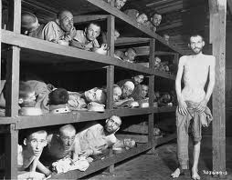
The Holocaust
“Destruction or slaughter on a mass scale”
Shoah – Hebrew term, meaning “Catastrophe”
Systematic stripping of Jewish identity

Slide 6
Band of Brothers Scene

Slide 7
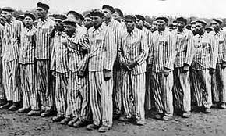
Excerpt from Mein Kampf
Read the selection and answer the questions that follow…

Slide 8
Do Now: What stood out to you most about the reading last night?
Objectives: Students will be able to...(1) define concentration and extermination camps (2) explain the events leading up to the Holocaust.

Slide 9
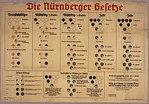
Nuremberg Laws (Sept. 1935)
Nazis began taking away German Jew’s right’s
Laws:
Took away citizenship
Banned marriage between Jews and other Germans
Defined Jew as a person with at least one Jewish Grandparent
Jews could not hold public office or voting

Slide 10
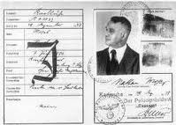
Nuremberg Laws Cont….
Passports of Jews were marked with a “J”
Reduced to a “J” on their passport...
By 1936 – ½ Jews lost jobs (Civil Servants, journalists, teachers, actors, farmers)
By 1938 – Jews banned from practicing law, medicine, or operating business

Slide 11
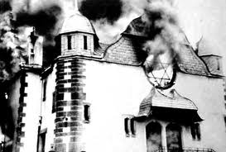
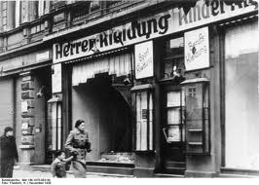
Kristallnacht
“The Night of Broken Glass” – Broken glass littered the street
Jewish Refugee shot and killed German diplomat in Paris
In retaliation, Hitler ordered staged attacks on Jewish stores that were supposed to look like a response

Slide 12
Kristallnacht Cont…
“They yanked out every drawer in every one of our chests and cupboards, and tossed each in the air. They let the cutlery jangle across the floor, the clothes scatter, and stepped over the mess to fling the next drawer. . . . ‘We might be back,’ the leader said. On the way out he threw our mother-of-pearl ashtray over his shoulder, like confetti. We did not speak or move or breathe until we heard their boots against the pavement.”

Slide 13
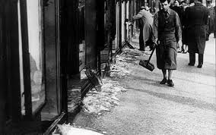
Aftermath…
90 Jews dead, hundreds badly injured, and thousands terrorized
7,500 business and 180 synagogues destroyed
Hitler's banned police intervention

Slide 14
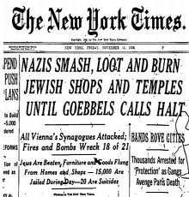
Results of Kristallnacht?
Gestapo (Secret Police) arrested 20,000 wealthy Jews
State confiscated insurance payments
Jewish community fined for damages…

Slide 15
Refugees
Jews fled (or attempted to flee) Germany and Nazi controlled states
Albert Einstein and Otto Frank (Anne Frank)
1938 – US Consulate 100,000 person backlog for Visa’s
Many remained stuck in Nazi-controlled Europe

Slide 16
Final Solution
Nazi leaders met at Wannsee Conference to determine “Final solution to the Jewish Question”
Decided to round up and move the Jews to detention centers
Concentration Camps – Healthy individuals worked as slave laborers
Extermination Camps – Execution camps

Slide 17
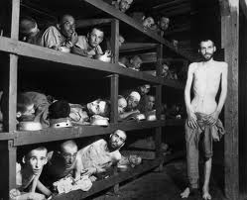
Concentration Camps
Buchenwald – Largest (200,000 prisoners throughout)
Conditions
12 Hour Shifts
150 people in rooms made for 50

Slide 18
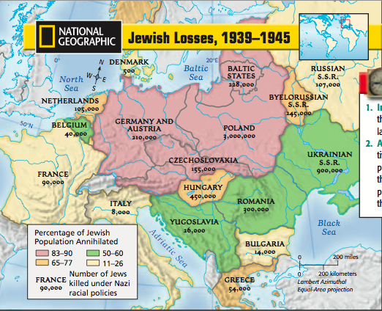
Extermination Camps
Treblinka and Auschwitz - Two more well-known camps

Slide 19
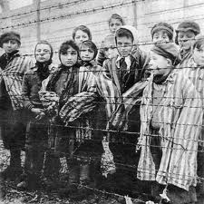
How could this happen?
No clear consensus has been reached:
Economic problems
Hitler’s control over Germany
Lack of strong representative government
Fear of secret police
History of anti-Semitism

