Slide 1
Do Now: What is the best invention of your lifetime?
Objectives: Students will be able to...(1) define the major transportation inventions of the early 1800's (2) use critical thinking to analyze major industries of the time
Homework: Finish worksheet on 7.2 DUE TOMORROW

Slide 2
Do Now: Share your homework with someone next to you. What were the similarities and differences?
Objectives: Students will be able to...(1) define the major transportation inventions of the early 1800's (2) use critical thinking to analyze major industries of the time
Homework: Notes on 7.2 (With CCQ’s)

Slide 3
What do you think will be the next “Big Thing”? What inventions have changed our lives? How would our lives be different without certain things?
https://www.youtube.com/watch?v=Kg4nHNQrKrs

Slide 4
Working with a partner define the terms below from Chapter 7, Section 2:
National Road:
Steamboat:
Canal:
“Iron Horse”:

Slide 5
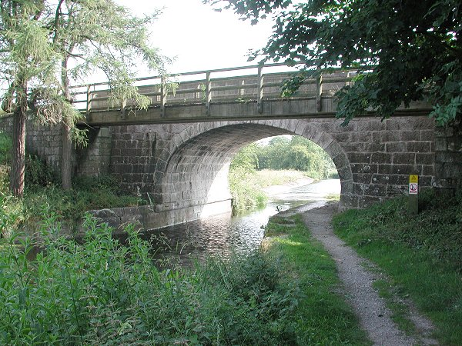
First Turnpike- 1790 Lancaster, PA
By 1832, nearly 2400 mi. of road connected most major cities.

Slide 6
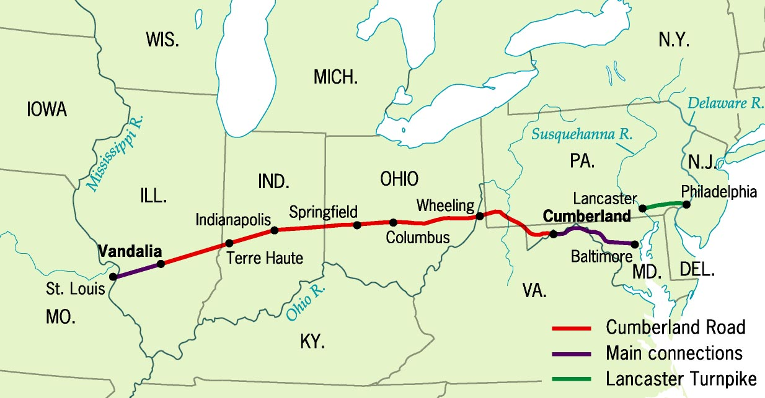
Cumberland (National Road), 1811

Slide 7
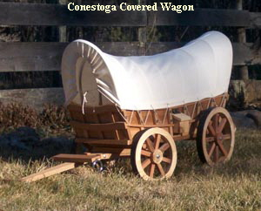
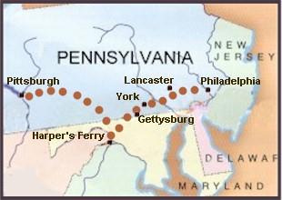
Conestoga Covered Wagons
New Wagons and paved roads allow goods to be shipped to more locations faster and cheaper
Conestoga Trail, 1820s

Slide 8
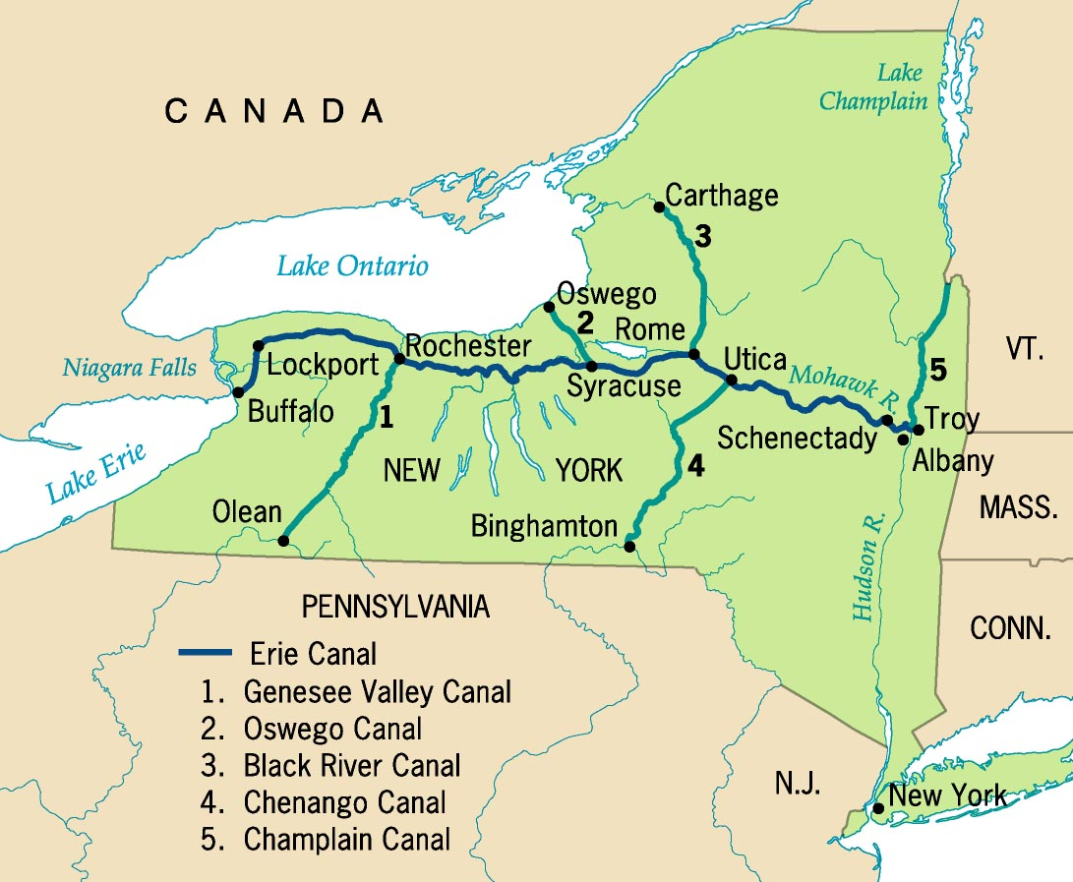
Erie Canal System

Slide 9
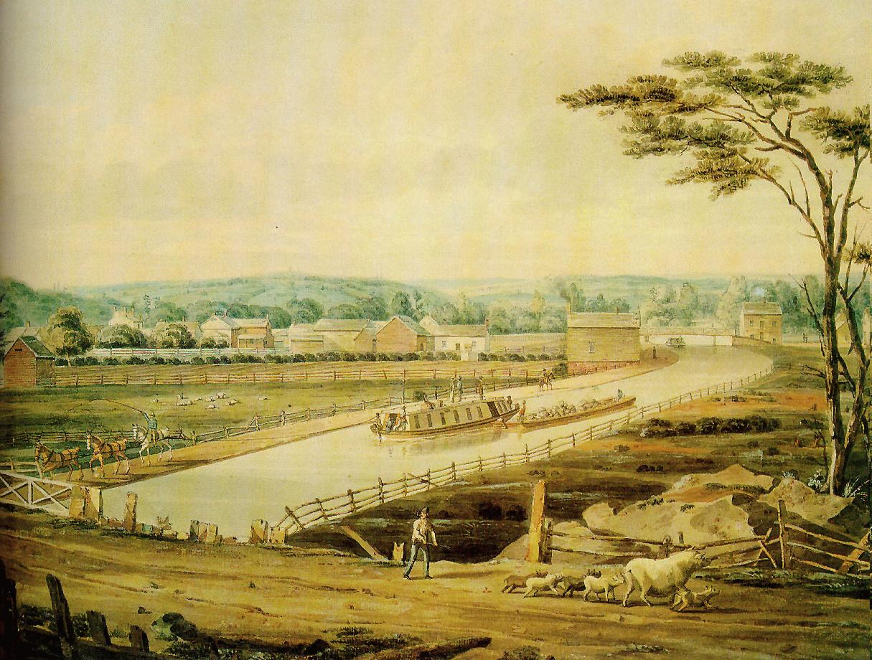
Erie Canal, 1820s
Begun in 1817; completed in 1825

Slide 10
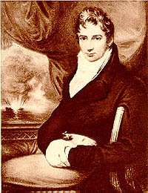
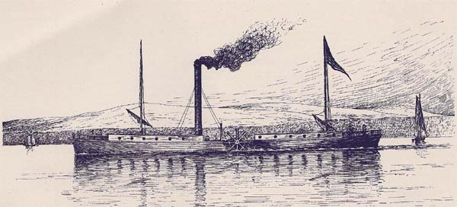
Robert Fulton & the Steamboat
Can travel up stream
1807: The Clermont

Slide 11
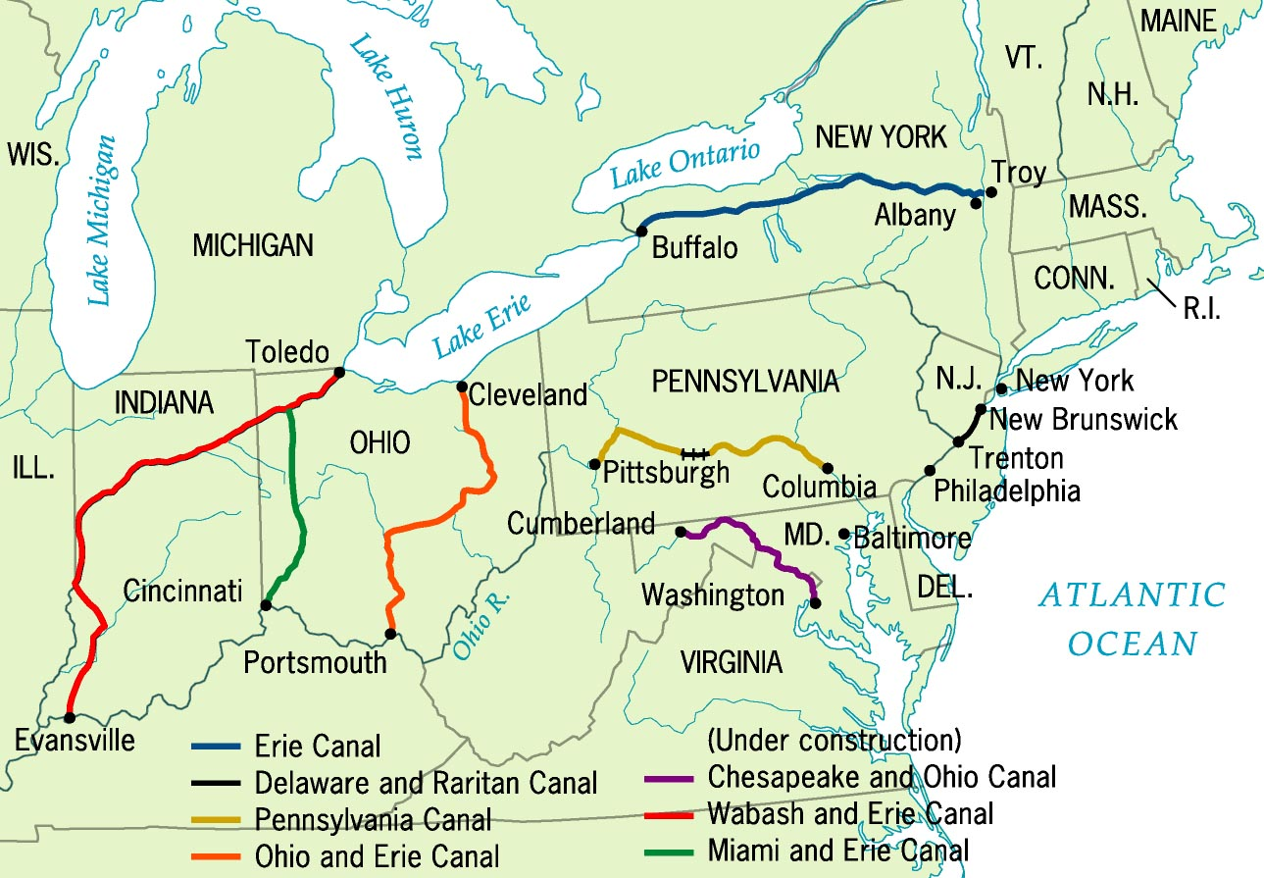
Principal Canals in 1840

Slide 12
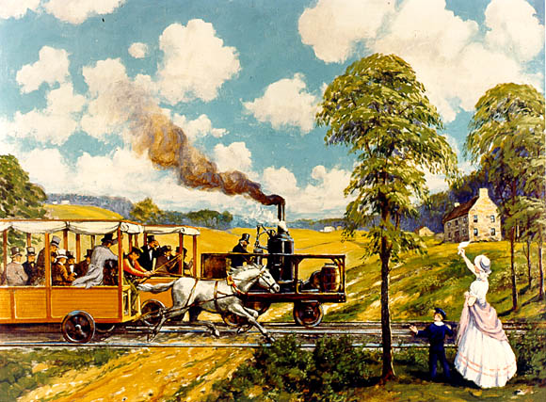
The “Iron Horse” Wins! (1830)
1830 → 13 miles of track built by Baltimore & Ohio RR By 1850 → 9000 mi. of RR track [1860 → 31,000 mi.]

Slide 13
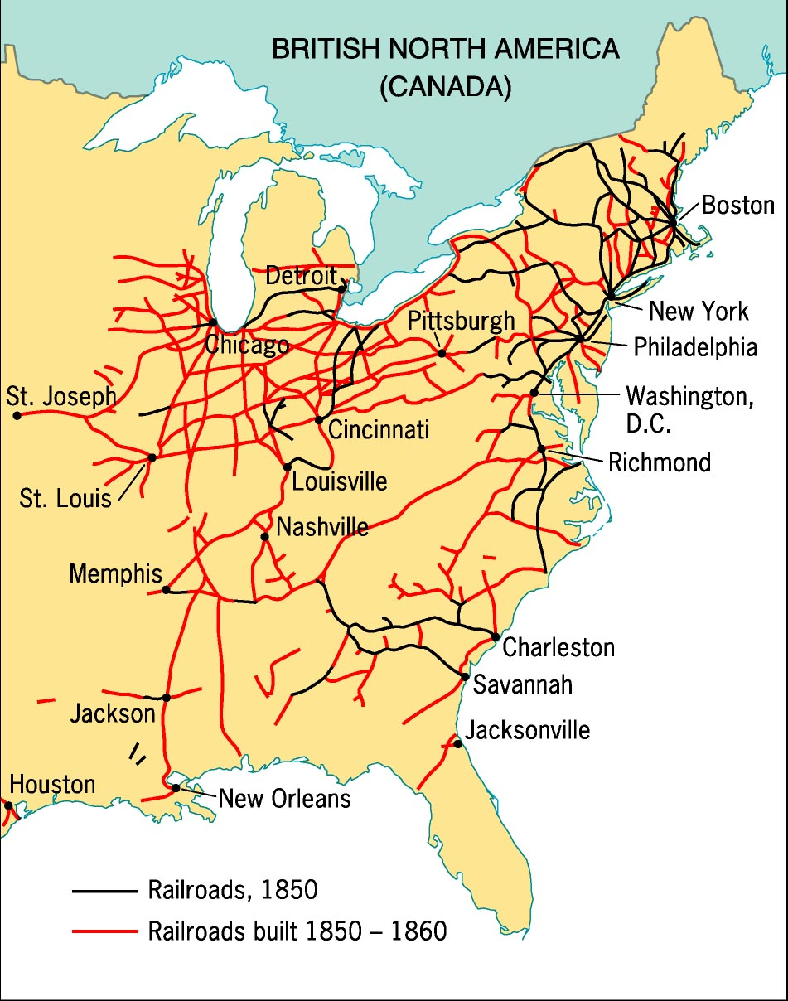
The Railroad Revolution, 1850s
Immigrant labor built the North RRs.
Slave labor built the South RRs.
Allows for more settlement of the West
Goods can be shipped to new places

Slide 14
Other Inventions of the 1800s
Complete the worksheet with a partner near you.

Slide 15
Do Now: How would you handle these scenarios without technology

Slide 16
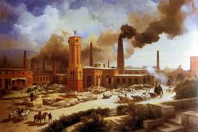
Industrial Revolution North
Started in England
Small hand tools became BIG machines
Samuel Slater snuck in British technology!
Used to make textiles, lumber, shoes, leather, wagons, etc.

Slide 17
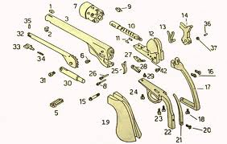
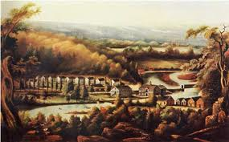
Advances in Technology
Eli Whitney – Great New England Inventor
Interchangeable Parts – Machines made identical parts that were assembled by workers
First did this with Gun making
Samuel Morse – Morse Code
First telegraph line connected Washington D.C. and Baltimore
Over 50,000 miles of telegraph line connected the country!

Slide 18
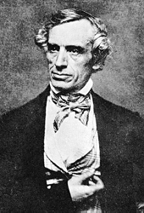
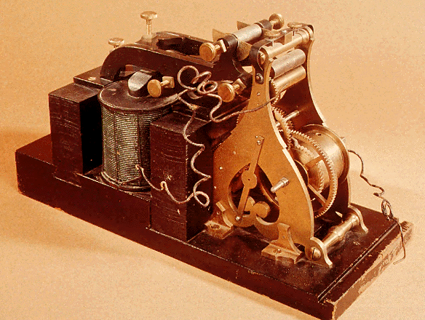
Samuel F. B. Morse
First telegraph line connected Washington D.C. and Baltimore
Over 50,000 miles of telegraph line connected the country!
1840 – Telegraph

Slide 19
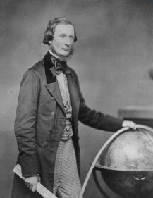
Cyrus Field & the Transatlantic Cable, 1858
Information spread faster making the world seem smaller

Slide 20
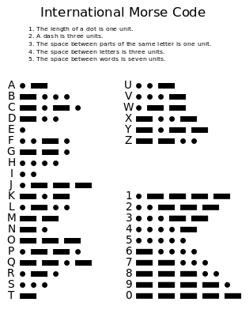

Slide 21
The Northern
Industrial
"Juggernaut"

Slide 22
Distribution of Wealth
During the American Revolution, 45% of all wealth in the top 10% of the population.
1845 Boston → top 4% owned over 65% of the wealth.
1860 Philadelphia → top 1% owned over 50% of the wealth.
The gap between rich and poor was widening!

Slide 23
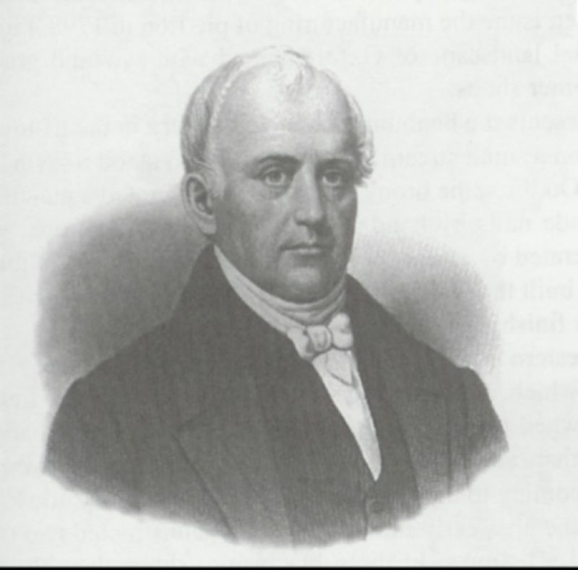
Samuel Slater (“Father of the Factory System”)
Works in British Factory and steals ideas for their machines

Slide 24
The Lowell/Waltham System: First Dual-Purpose Textile Plant
Francis Cabot Lowell’s town - 1814

Slide 25
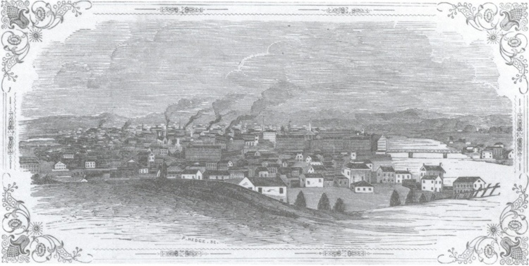
Lowell in 1850

Slide 26
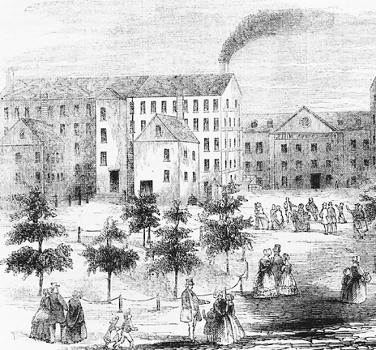
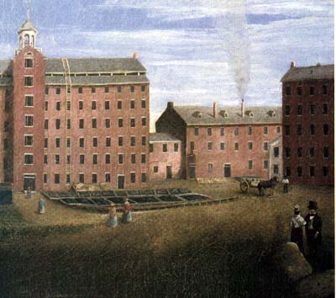
Lowell Mill

Slide 27
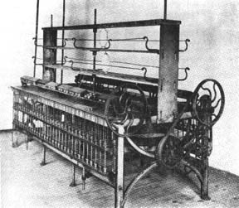
Early Textile Loom 1785-1830

Slide 28
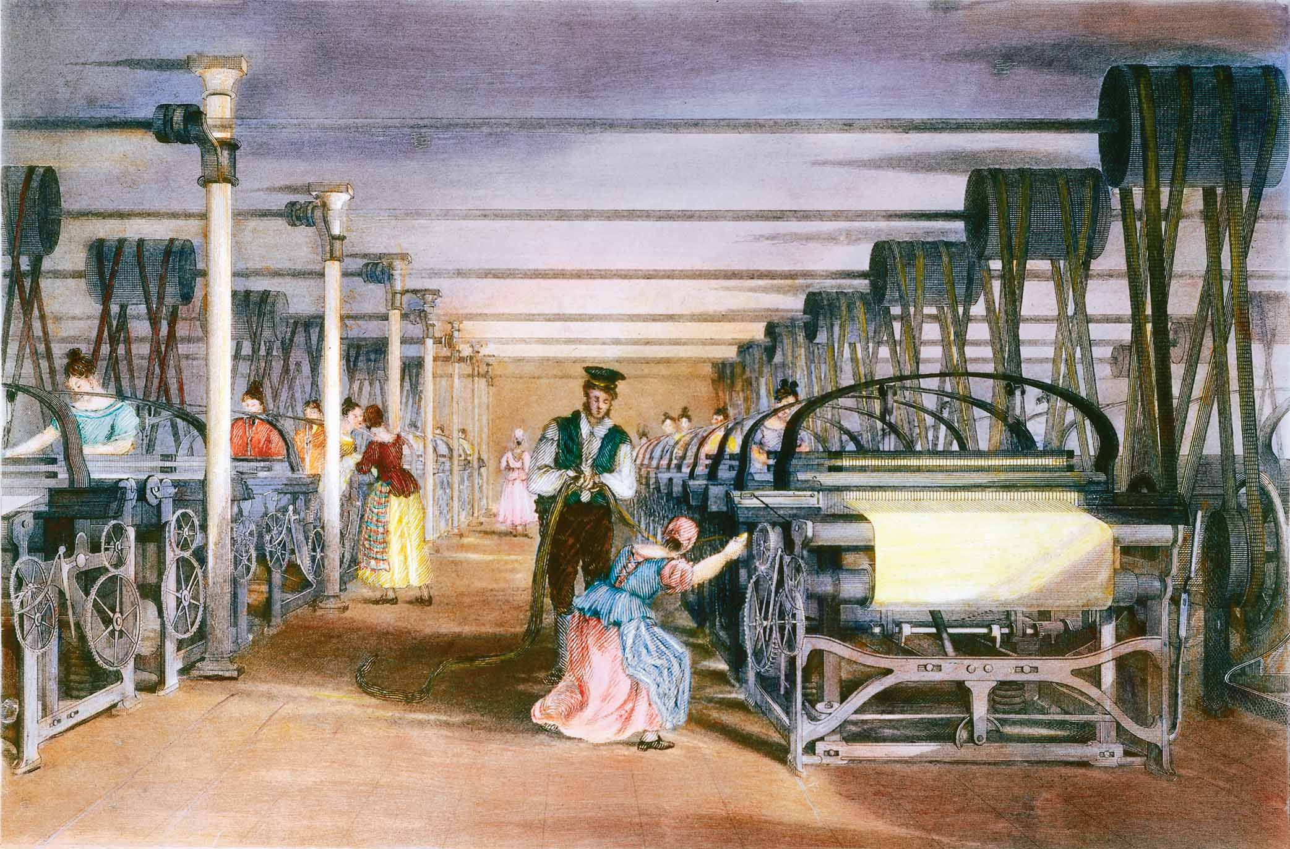
Early Textile Mill Loom Floor

Slide 29
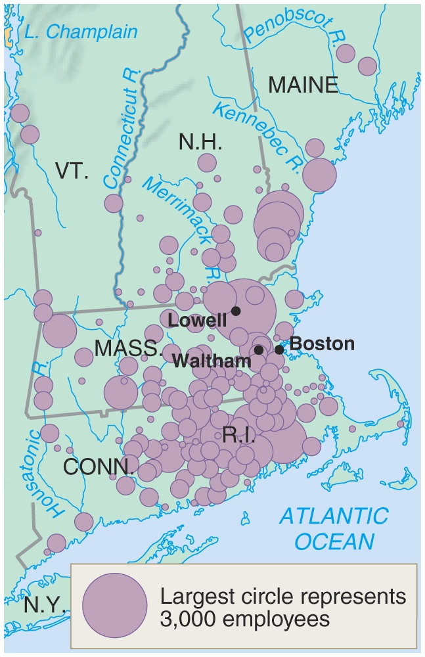
New England Textile Centers: 1830s

Slide 30
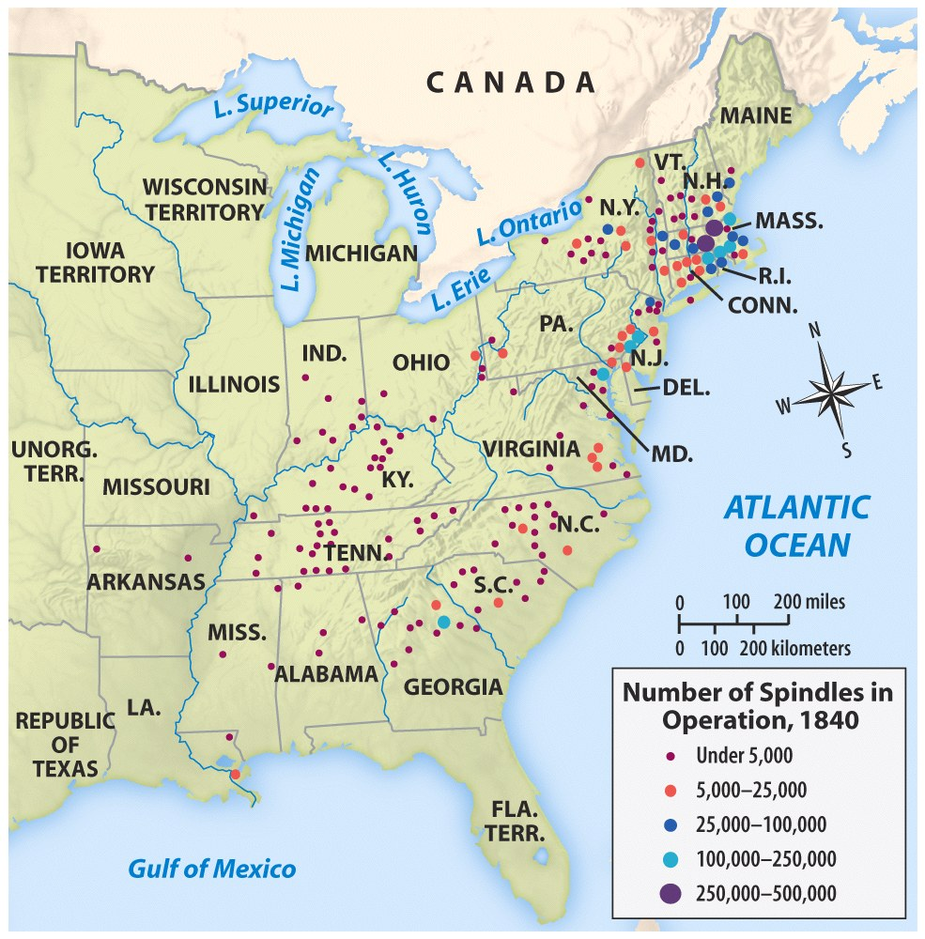
New England Dominance in Textiles
North had more textile factories but depended on the cotton from the South

Slide 31
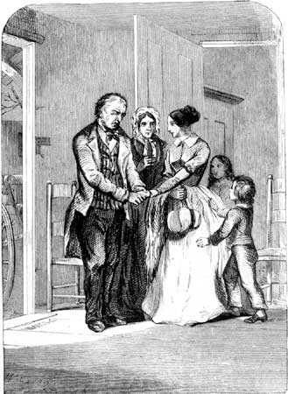
Starting for Lowell

Slide 32
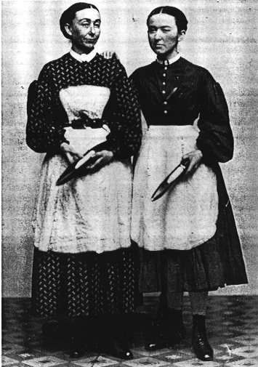
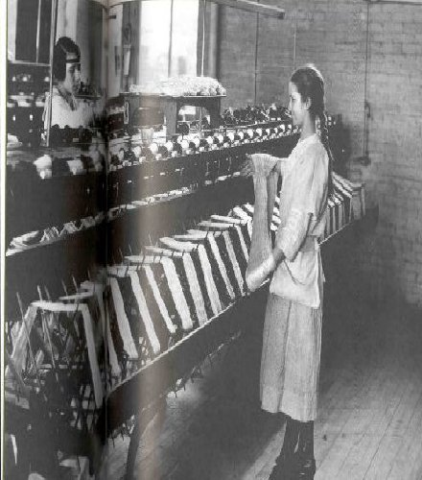
Lowell Girls
Average age – 24
Contracts for 1 year (average stay 4 years)
5 am -7 pm (Average 73 hrs week)
Average salary $2-3 a week
Challenge traditional female roles but paid half as much as a men
What was their typical “profile?”

Slide 33
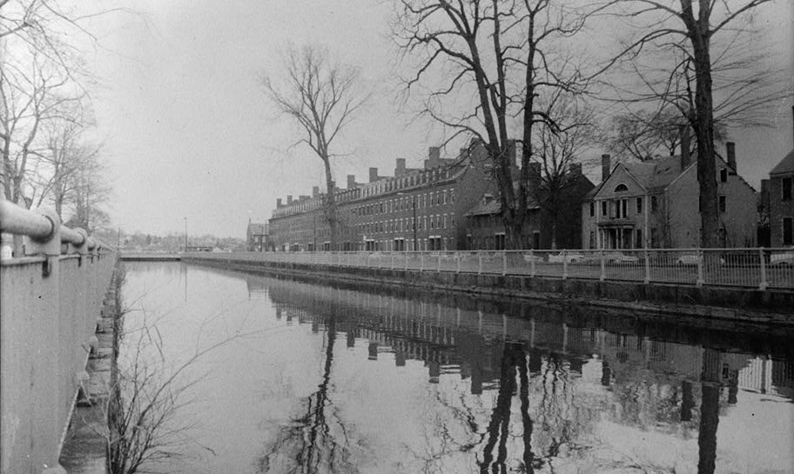
Lowell Boarding Houses
25-40 women lived in each boarding house, with up to six sharing a bedroom
Cost 1.25-1.50 a week
Would foster community as well as resentment
What was boardinghouse life like?

Slide 34
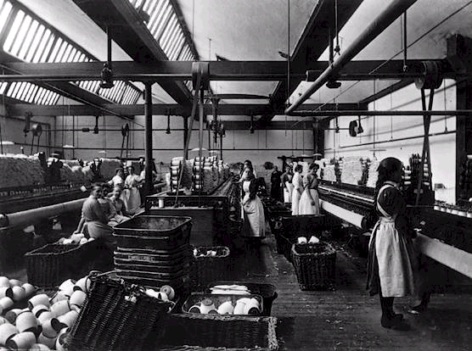
Irish Immigrant Girls at Lowell

Slide 35
Investment Game
You will have the chance to invest in 5 different rounds – 1820, 1830,1840,1850,1860
You will have a $1,000 dollars to invest with in each round (you don’t reinvest your earnings)
You can invest all 1,000 in one company or invest 500 in two companies. (You can not invest in more the 2 companies)
During each round you will write next to “Round Earned” why you invested in that company at that time.
Remember to keep in mind when things were invented

Slide 36
Enterprise | 1820-29 500 1000
Lowell Textile | 0 | 0
Lancaster Turnpike | 200 | 400
Ohio and Erie Canal | 50 | 100
Western Steamboat | 100 | 200
Baltimore and Ohio Railroad | 0 | 0
Magnetic Telegraph Co. | 0 | 0

Slide 37
Enterprise | 1820-29 500 1000 |  | 1830-39 500 1000
Lowell Textile | 0 | 0 | 150 | 300
Lancaster Turnpike | 200 | 400 | 150 | 300
Ohio and Erie Canal | 50 | 100 | 150 | 300
Western Steamboat | 100 | 200 | 200 | 400
Baltimore and Ohio Railroad | 0 | 0 | 100 | 200
Magnetic Telegraph Co. | 0 | 0 | 0 | 0

Slide 38
Enterprise | 1820-29 500 1000 |  | 1830-39 500 1000 |  | 1840-49 500 1000
Lowell Textile | 0 | 0 | 150 | 300 | 250 | 500
Lancaster Turnpike | 200 | 400 | 150 | 300 | 50 | 100
Ohio and Erie Canal | 50 | 100 | 150 | 300 | 100 | 200
Western Steamboat | 100 | 200 | 200 | 400 | 300 | 600
Baltimore and Ohio Railroad | 0 | 0 | 100 | 200 | 200 | 400
Magnetic Telegraph Co. | 0 | 0 | 0 | 0 | 50 | 100

Slide 39
Enterprise | 1820-29 500 1000 |  | 1830-39 500 1000 |  | 1840-49 500 1000 |  | 1850-59 500 1000
Lowell Textile | 0 | 0 | 150 | 300 | 250 | 500 | 300 | 600
Lancaster Turnpike | 200 | 400 | 150 | 300 | 50 | 100 | 0 | 0
Ohio and Erie Canal | 50 | 100 | 150 | 300 | 100 | 200 | 50 | 100
Western Steamboat | 100 | 200 | 200 | 400 | 300 | 600 | 200 | 400
Baltimore and Ohio Railroad | 0 | 0 | 100 | 200 | 200 | 400 | 300 | 600
Magnetic Telegraph Co. | 0 | 0 | 0 | 0 | 50 | 100 | 150 | 300

Slide 40
Enterprise | 1820-29 500 1000 |  | 1830-39 500 1000 |  | 1840-49 500 1000 |  | 1850-59 500 1000 |  | 1860-69 500 1000
Lowell Textile | 0 | 0 | 150 | 300 | 250 | 500 | 300 | 600 | 300 | 600
Lancaster Turnpike | 200 | 400 | 150 | 300 | 50 | 100 | 0 | 0 | 0 | 0
Ohio and Erie Canal | 50 | 100 | 150 | 300 | 100 | 200 | 50 | 100 | 0 | 0
Western Steamboat | 100 | 200 | 200 | 400 | 300 | 600 | 200 | 400 | 50 | 100
Baltimore and Ohio Railroad | 0 | 0 | 100 | 200 | 200 | 400 | 300 | 600 | 400 | 800
Magnetic Telegraph Co. | 0 | 0 | 0 | 0 | 50 | 100 | 150 | 300 | 300 | 600

Slide 41
Enterprise | 1820-29 500 1000 |  | 1830-39 500 1000 |  | 1840-49 500 1000 |  | 1850-59 500 1000 |  | 1860-69 500 1000
Lowell Textile | 0 | 0 | 150 | 300 | 250 | 500 | 300 | 600 | 300 | 600
Lancaster Turnpike | 200 | 400 | 150 | 300 | 50 | 100 | 0 | 0 | 0 | 0
Ohio and Erie Canal | 50 | 100 | 150 | 300 | 100 | 200 | 50 | 100 | 0 | 0
Western Steamboat | 100 | 200 | 200 | 400 | 300 | 600 | 200 | 400 | 50 | 100
Baltimore and Ohio Railroad | 0 | 0 | 100 | 200 | 200 | 400 | 300 | 600 | 400 | 800
Magnetic Telegraph Co. | 0 | 0 | 0 | 0 | 50 | 100 | 150 | 300 | 300 | 600

