Slide 1
Do Now: If you were going to the White House for a party what would you bring?
Objectives: Students will be able to...(1) describe the personality of Andrew Jackson (2) identify main ideas from a video
Homework: 8.1 Worksheet (EMAILED TO YOU) – DUE THURSDAY

Slide 2
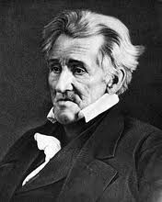
Essential Question: "How was Andrew Jackson different from other presidents? Does that make him better or worse?"
Objectives: Students will be able to...
describe the personality of Andrew Jackson
identify main ideas from text
Homework: BRING IN SMALL THINGS YOU COULD TRADE WITH OTHER PEOPLE (I’ll explain)
8.1 Worksheet DUE THURSDAY

Slide 3
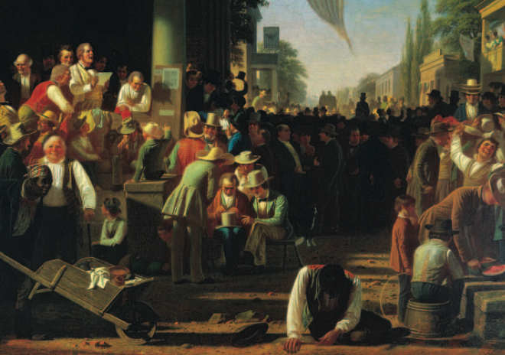
We begin Chapter 8 The Spirit of Reform

Slide 4
Do Now: Read “An American Story” on page 266 and answer these questions
How does Margaret describe the crowd in the first paragraph?
How did Jackson break a long standing tradition?
What happened to the Jackson and the White House when he let the crowd in?
Why do you think people were so happy about Jackson becoming President?

Slide 5
Jackson – The People’s President
‘Old Hickory’
Born in a log cabin
Never went to college
Orphaned at age 14
Hero of Battle of New Orleans (War of 1812)
Famous for violent personal fights (5-100 Duels)
Became more mild once elected President
http://www.youtube.com/watch?v=-19w8urHy9M

Slide 6
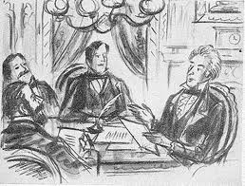
Spoils System – “To the Victor goes the Spoils!”
Felt that MAJORITY should rule → People should play a role
Created the SPOILS SYSTEM – Appointing people for jobs based on party loyalty
1st to Force out old employees and fill with his own

Slide 7
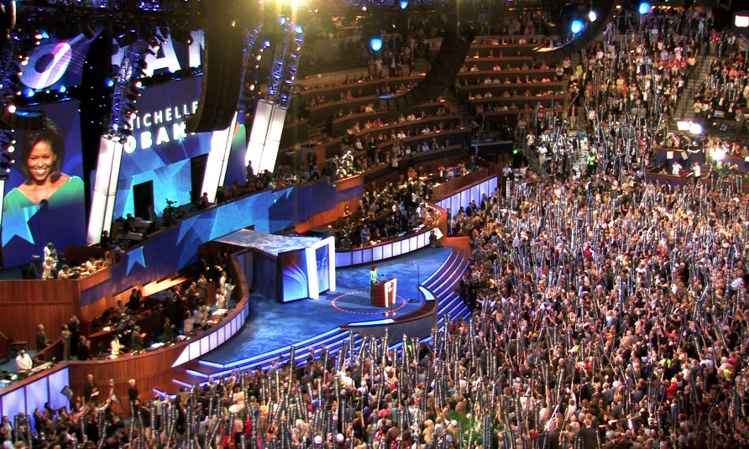
New Election
Caucus System - Members of Congress from that party chose candidate (OLD WAY)
National Nominating Convention – Held gatherings where state delegates debated candidates (NEW WAY)
How is this better or worse?

Slide 8
President’s Series (Andrew Jackson)
http://www.youtube.com/watch?v=oxDqOH6H4FQ (History Channel)
https://www.youtube.com/watch?v=EGfxyeuy8u8 (PBS)
TAKE NOTES ON MAJOR EVENTS THAT HAPPEN DURING HIS PRESIDENCY.

Slide 9
Ticket to Leave
How was Andrew Jackson different from other presidents? Does that make him better or worse?

Slide 10
Do Now: 1. Grab a notecard and take out your homework (small things to trade). 2. Why do you think people trade? What is the point?
Objectives: Students will be able to...(1) describe why the Tariff of Abominations angered the South (2) explain the nullification crisis.
Agenda:
Trading activity
Tariff of Abominations
Nullification Crisis
Homework: 8.1 DUE THURSDAY (TOMORROW)

Slide 11
Trading Game Rules
We will have four 5 Minutes rounds for you to trade things with people.
Each round will have different rules.
After each round we will rank on a scale of 1-10 how easy or hard trading under those restrictions was.
You do not need to trade something each round.
You CAN trade more than one thing each round.
You CAN trade multiple objects for one
No CHEATING! :P

Slide 12
Round 1
You may only trade in the groups below:
1-3
4-6
7-10
11-13
14-16
17-19
20-22

Slide 13
Round 2
You may only trade in the groups below:
1, 5, 10, 15, 20
2, 6, 11, 16, 21
3, 7, 12, 17, 22
4, 8, 13, 18,
5, 9, 14, 19,

Slide 14
Round 3
You may only trade in the groups below:
Even numbers
Odd numbers

Slide 15
Round 4
You may trade with ANYONE in the room.

Slide 16
Questions
Which round was the easiest to trade in?
Which was the hardest?
When were you the most frustrated?

Slide 17
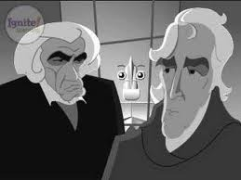
Tariff of Abominations
South Carolina economy weakening because of tariffs
Few industries in South Carolina meant lots of stuff from overseas
Tariffs hurt South
New tax in 1828 – Tariff of Abominations
Threatened to secede – leave the country
https://www.youtube.com/watch?v=VNgIUUD7i-A

Slide 18
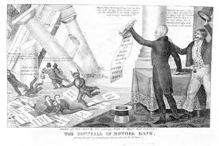
Nullification Crisis
John C. Calhoun and South Carolina furious!
Believe they can nullify laws if they don’t like them
Debates raged on for years!
Jackson almost attacks South Carolina (Force Bill)
Henry Clay – Another compromise – Reduce tariffs slowly for next 11 year

Slide 19
Ticket to Leave:
Why was South Carolina so upset?
How was the problem solved?

Slide 20
Do Now: Finish this sentence, "If Mr. Collison made me walk to Oklahoma I would_________”
Objectives: Students will be able to...
explain the Trail of Tears
analyze information from primary sources and images.
HOMEWORK: 8.2 NOTES DUE MONDAY

Slide 21
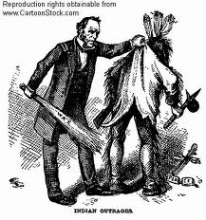
Native Americans in America…
Indian Removal act (1830) – Gave $$$$ to Native Americans if they relocated
Most gave in, Cherokee didn’t…
Took case to Court (Worcester vs. Georgia)
Chief John Marshall sided with Indians
Jackson ignored the decision

Slide 22
Finish your task from yesterday – Trail of Tears packet
You are acting as newspaper reporters gathering evidence on the removal of the Indians.
Once you collect some evidence (Provided by Mr. Collison) you will write a one paragraph news article supporting or opposing the Trail of Tears (YOU CAN DO THIS ON THE BACK OF YOUR THIRD SHEET OF PAPER)

Slide 23
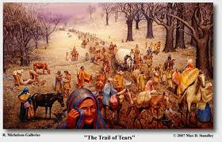
Trail of Tears

Slide 24
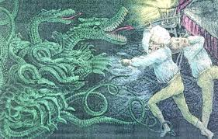
Do Now: Grab worksheet from the front, and do the “I See/It Means” Part

Slide 25
Objectives:
Students will be able to…
Describe Andrew Jackson’s hatred of the bank
Explain the changing culture in the US

Slide 26
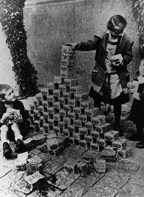
Second National Bank
Jackson HATED it
Why he hated it:
Banks giving out more paper money than gold and silver backing it up
Felt it was a monopoly
And unconstitutional

Slide 27
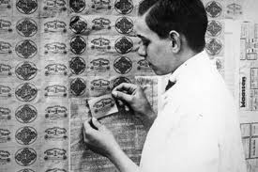

Slide 28
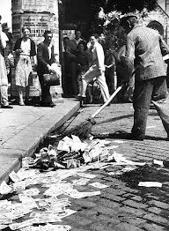
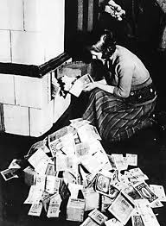

Slide 29
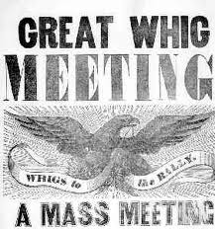
Jackson’s Enemies
Because he was forceful and aggressive, he gained enemies (WHIGS)
Larger federal government
Industrial and commercial development
Centralized economy (National Bank)

Slide 30
Next Presidents…
Martin Van Buren (8th President)
Democrat
Panic of 1837 – economic crisis, banks/businesses failed
Didn’t handle well

Slide 31
“Tippecanoe and Tyler Too”
William Henry Harrison (9th President)
Whig – died 32 days after becoming President
Hero of Battle of Tippecanoe (War 1812)
John Tyler (10th President)
Became president after Henry Harrison died
“His Accidency”
Webster-Ashburton Treaty – set a firm boundary between US and Canada

