Slide 1
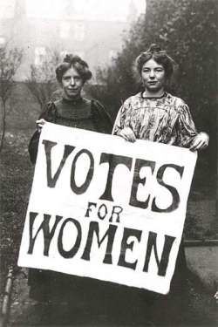
Do Now: 1. Write down one nice or fun thing you did over break 2. Take out your Reform Movement Brochure projects from before break.
Objectives: Students will be able to...(1) explain a major reform movement (2) transfer knowledge to a project.
Homework: 9.1 DUE WEDNESDAY

Slide 2
Lets Review Some of the Movements…
Temperance Movement -
Prison Reform -
Education Reform -
Women’s Education -
Women getting better rights -
Abolition -

Slide 3
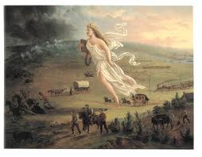

Slide 4
Essential Question: What was life like on the Oregon Trail?
Agenda:
Projects
Manifest Destiny
Life on the trail
Homework:
Oregon Trail Worksheet
9.1 Notes Due WEDNESDAY
Objectives: Students will be able to...
define Manifest Destiny
Analyze a text for key information

Slide 5
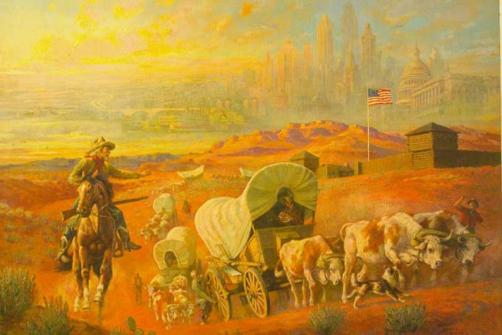
Manifest Destiny
The idea that God had given the continent to Americans to settle west
Set their sights on:
Oregon
California

Slide 6
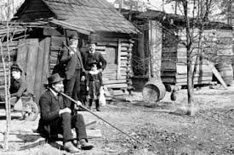
People who went West…
Squatters – people who settled on land they didn’t own
Overlanders – people who found their own way using guidebooks

Slide 7
What do you think were reasons people would want to go west?

Slide 8
What were the dangers?

Slide 9
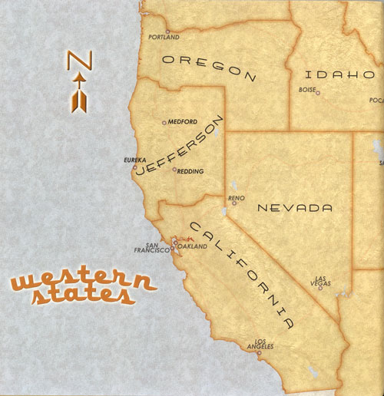
New Areas to Settle
Oregon – US and Britain both owned it
California – Controlled by Mexico

Slide 10
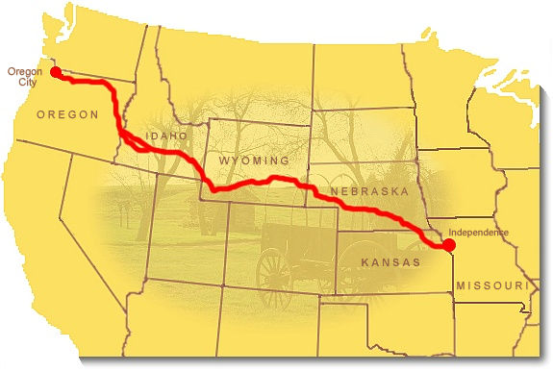
Oregon Trail
Trail or road across the country

Slide 11
Life on the Trail
Complete the worksheet on your own…

Slide 12
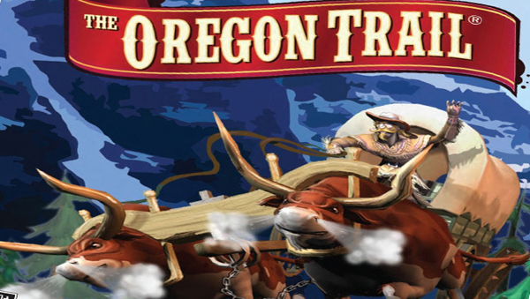
Lets play the game…

Slide 13
Do Now: Grab a worksheet and complete the ‘Do Now’
Objectives: Students will be able to...(1) Describe how we acquired Texas (2) identify key information from a PowerPoint
Homework: 9.2 DUE Tomorrow

Slide 14
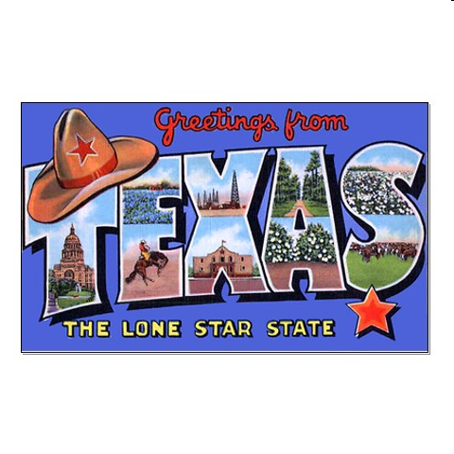

Slide 15
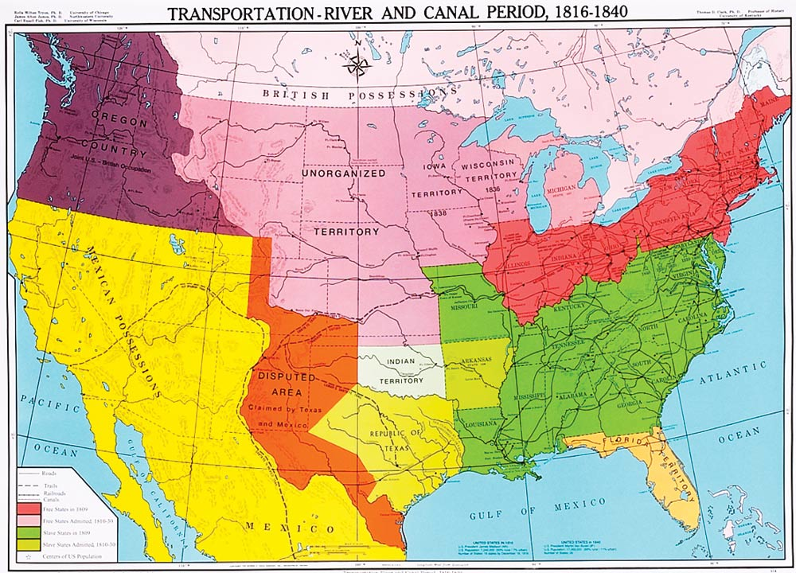
Map of US 1840

Slide 16
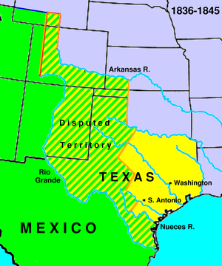
Texas:
Under Mexican control
Tejanos – Spanish speaking inhabitants (people who lived there)
Encouraged Americans to move there because Mexicans to scared to move near Native Americans.

Slide 17
Moving to Texas
Laws:
Cheap Land
No Taxes 10 Ypears
Conditions:
Become Mexican Citizens
Live under Mexican Law
Convert to Roman Catholic

Slide 18
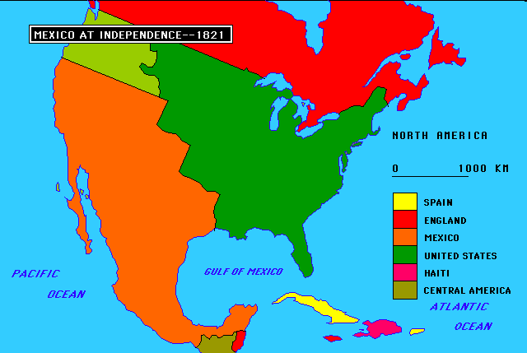
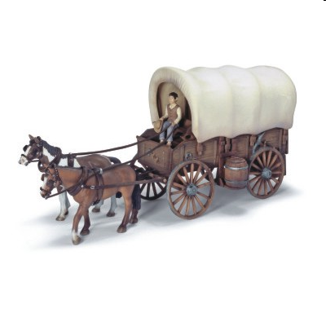
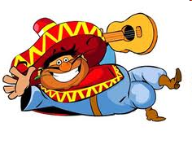
Amigos!
Empresarios – “Agents” or “Contractors” who got people to settle the land (Stephen Austin – Successful)

Slide 19
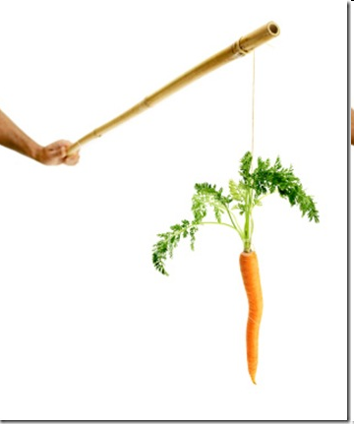
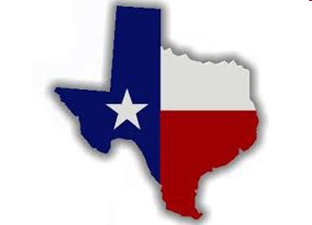
Incentives
Please Help
Develop
our Land.

Slide 20
Please Help
Develop
our Land.

Slide 21
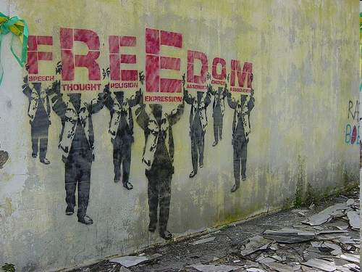
Please Help
Develop
our Land.
POLITICAL

Slide 22
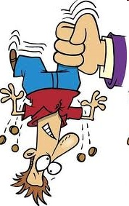
Please Help
Develop
our Land.
LOW

Slide 23
Please Help
Develop
our Land.

Slide 24
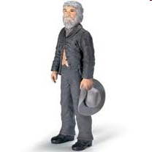
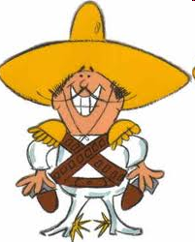
Americans Outnumber Mexicans 1830

Slide 25
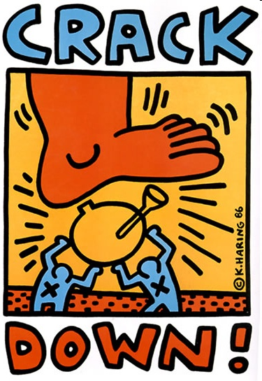
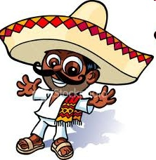
No More American
Immigration to Texas

Slide 26
No More
Self-Government

Slide 27
Crash Course – Texas Revolution
This will review what we just learned and introduce what we will do tomorrow.
https://www.youtube.com/watch?v=tkdF8pOFUfI&list=PL8dPuuaLjXtMwmepBjTSG593eG7ObzO7s

Slide 28
Do Now: Answer these questions (True/False) to the best of your knowledge – guess if you have to!
The Mexican government invited American citizens to come live in Texas, an area of land they owned.
Texans lost a battle against Mexican soldiers by having every single one of their soldiers killed.
It’s is impossible to lose a small battle, and have it be a good thing for the war.
The battle that eventually won the war for the Texans lasted only 18 minutes, they killed 700 Mexicans, captured 700, and lost only 9 soldiers in the process.
When Texas won their independence then immediately were accepted as a new state in the US.

Slide 29
Essential Question: how did the Mexican War go?
Objectives: Students will be able to...(1) Describe how we acquired Texas (2) identify major battles (Alamo, San Jacinto, Goliad)
Homework: 9.3 DUE TUESDAY

Slide 30
Background
Santa Anna – President of Mexico
Arrests Stephen Austin and takes over Mexico
Once Austin released he realizes war with Mexico is necessary!

Slide 31
Read about the assigned battle in your group and answer the following: 1. Which famous people were involved? (Why were they famous?) 2. Who won the battle(s)? 3. Why were they important? 4. Is there anything else your group mates should know?
Early Part of War
Alamo
Goliad
San Jacinto

Slide 32
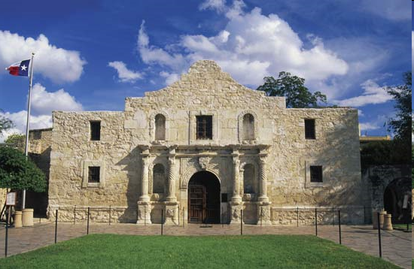
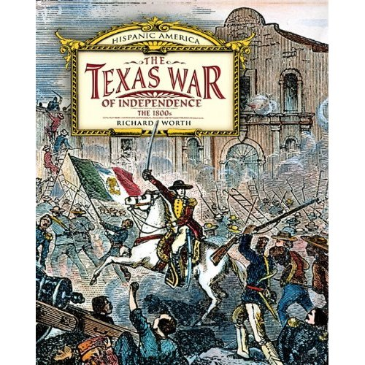
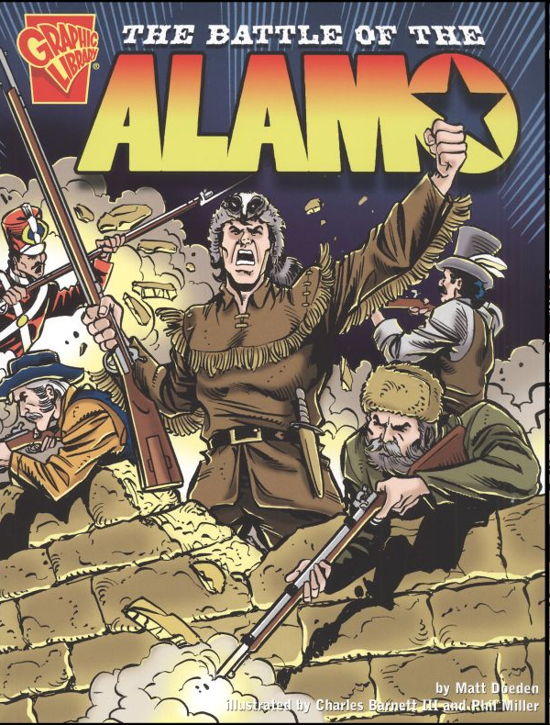

Slide 33
February 23 – March 6, 1836
was a pivotal event in the Texas Revolution. Following a 13-day siege, Mexican troops launched an assault on the Alamo Mission near San Antonio

Slide 34
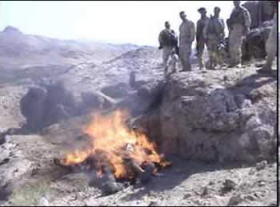
In the early morning hours of March 6, the Mexican Army advanced on the Alamo and killed approximately 200 Texans. After the battle, the Texan bodies were burned.

Slide 35
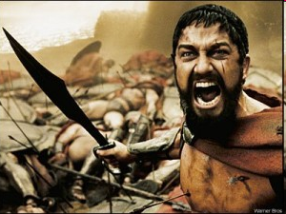

Slide 36
http://www.youtube.com/watch?v=vAMZQlAQAyQ

Slide 37
The Battle of San Jacinto, fought on April 21, 1836, was the decisive battle of the Texas Revolution. Led by General Sam Houston, the Texas Army engaged and defeated General Santa Anna's Mexican forces in a fight that lasted just eighteen minutes. About 700 of the Mexican soldiers were killed and 730 captured, while only nine Texans died.

Slide 38
Santa Anna, the President of Mexico, was captured the following day and held as a prisoner of war. Three weeks later, he signed a peace treaty that dictated that the Mexican army leave the region, paving the way for the Republic of Texas to become an independent country.

Slide 39
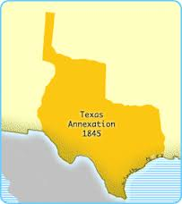
The Republic of Texas (1836)
Becomes own country first….
Vote SAM HOUSTON President
Vote for annexation
Definition – Become part of US

Slide 40
Ticket to Leave RAFT
Role | Audience | Format | Topic
American Citizen | President Tyler | Email | Texas Independence
Sam Houston | American Citizen | Text Message (3-4 Sentences) | The Battle of the Alamo
Mexican Citizen | Tejanos | Facebook Status (3-4 Sentences) | The Battle of San Jacinto
Santa Anna (Leader of Mexico) | Sam Houston | Letter | The Battle of Goliad

