Slide 1
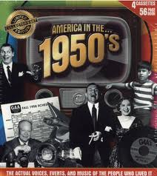
Do Now: How would you describe American Society today?
Objectives: Students will be able to...(1) describe American culture in the 1950's (2) analyze a visual for information

Slide 2
Homework: Notes on 27.2

Slide 3
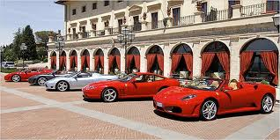
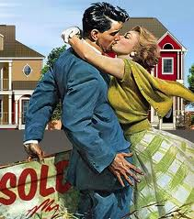
The Affluent Society
John Kenneth Galbraith – Talked about new American prosperity
“Economy of Abundance”
Wealth spread to all classes (More $$$)
People buying homes

Slide 4
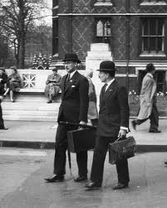
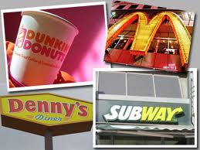
Business Changes
More White Collar Jobs
Sales, management, etc.
Less Blue Collar jobs
Physical labor industries
Multinational Corporations
Near materials, cheap labor
Franchises - Multiple locations
The Organization Man

Slide 5
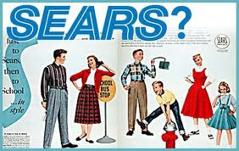
Consumerism
More $$, more luxury items
Advertising (Commercials)
http://www.youtube.com/watch?v=PFbCGT_AWBI

Slide 6
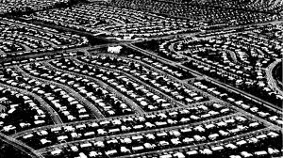
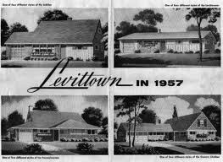
Suburbia & Family Life
Levittown – Earliest Suburbs
Baby Boom – Birth rate exploded (65 Mill. Babies Born)
Women – Traditional Homemakers
Day in the life - http://www.youtube.com/watch?v=Jqe4W08124M

Slide 7
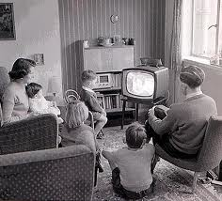
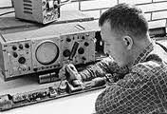
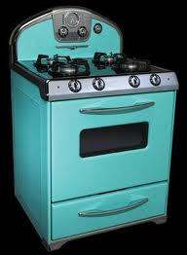
Technology
Age of computers – Allowed quicker and more efficient work
Medical:
Antibiotics
Arthritis, cancer, diabetes, heart attacks
Surgery
Jonas Salk – Cured polio

Slide 8
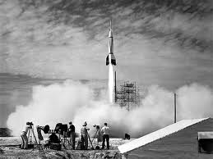
Conquering Space
Keep up with Soviets
Launched Satellite
Cross-country flights

