Slide 1
Do Now: Answer the following questions about Amazon
What do you know about Amazon?
What does Amazon sell?
Have you ever bought anything from Amazon?
How frequently do you, or someone you know, buy things from Amazon?
In your experience, are things from Amazon cheaper or more expensive?
Do you think Amazon is too powerful?

Slide 2
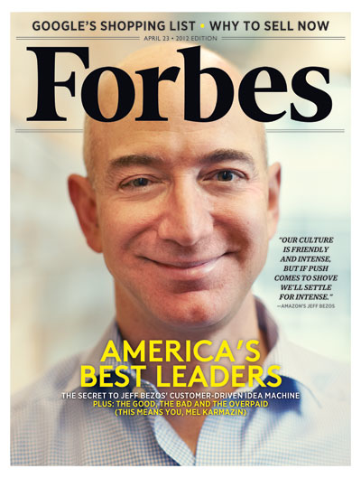
How it started?
Jeff Bezos founder – delivering things from his garage in 1995
Started with 6-12 orders a day
Site wasn’t even fully ready at launch (could order negative books!)
Packed everything themselves and shipped
Customers come first…

Slide 3
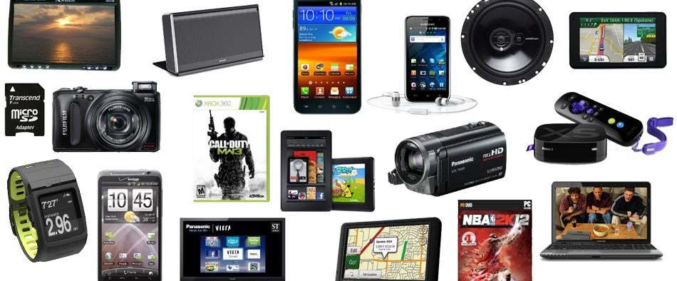
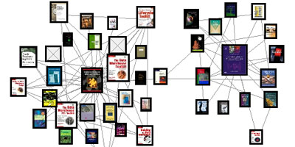
Products on Amazon
Things you can buy…
Books
Movies
CDs
TV shows
Office supplies
Razor blades
K-cups
Tea bags
Granite Polish/sealant
Pasta
Stethascope

Slide 4
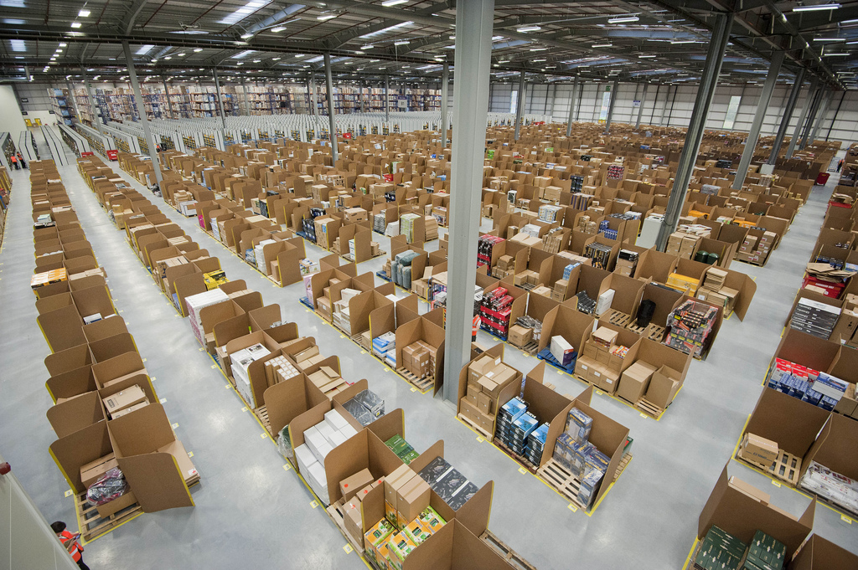
Things not for sale on Amazon…
Things he promises he wont ever sell:
Guns
Liquor
Real Estate
Pets
Cars
Fuel
Lottery Tickets
Tobacco
Prescription Eye Glasses
Used clothing

Slide 5
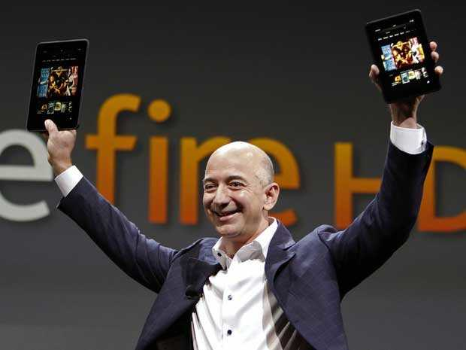
Amazon Innovations
On the Site:
1-click
Reviews
Wishlist
Pay to Quit
Kindle
Amazon Studios
Grocery Delivery
Factory Packaging systems
Amazon Cloud Services (For Companies)
Quick Deliveries (Their system)

Slide 6
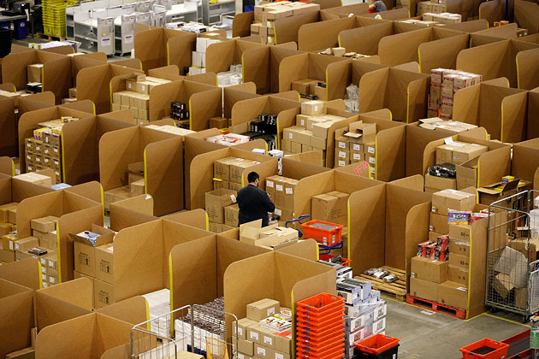
Here’s how it works, and a surprise innovation…

Slide 7
Are they approaching a monopoly?
Read through the article in the UpFront and answer the following questions:
How do they make their money?
Are you ok with them 'bullying' publishing companies?
Is that just good business or is that a monopoly?
Would any of what you’ve learned get you to use Amazon more, or less?

