Slide 1
Do Now: In your own words, define isolation and neutral.
Objectives: Students will be able to...
identify key details from images on American Isolationism
define Isolationism and Neutrality
speak and listen within a small group setting.

Slide 2
Agenda
Isolationism vs. Neutrality
Dr. Seuss
Save the Last Word
Homework: Mr. Collison now has added a 'Blog' function to his website. A question will be posted there, and I would like you to respond to my question in 3-4 sentences.

Slide 3
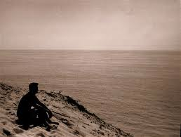
Isolationism vs. Neutrality?
What do they mean?
What’s the difference?

Slide 4
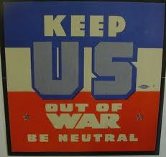
American Neutrality
Sacrifice of WWI seemed pointless with rise of Dictators…
Americans began to support Isolationism

Slide 5
Nye Committee
Isolationists got stronger in 1930s
Committee investigated if America was ‘tricked’ into joining the war…Tricked by who?
European countries refused to pay back debts
Made isolationism stronger.

Slide 6
Legislating Neutrality
Neutrality Act of 1935 – Made it illegal to sell arms to any country in war
Spanish Civil War – America had to stay neutral
Anti-Comintern Pact – Japan, Germany, Italy become AXIS POWERS
Neutrality Act of 1937 – Warring countries could buy nonmilitary stuff on “cash and carry” basis (Think WWI)

Slide 7
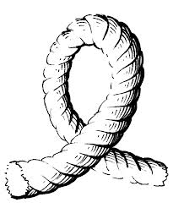
FDR and Internationlism
FDR wasn’t isolationist
Internationalism – Idea that trade between countries creates prosperity and helps prevent war
Loophole in the Neutrality Act (China vs. Japan)

Slide 8
Freedom from Fear
“When an epidemic of physical disease starts to spread, the community . . . joins in a quarantine of the patients in order to protect the health of the com- munity against the spread of the disease. . . . War is a contagion, whether it be declared or undeclared. . . . There is no escape through mere isolation or neutrality. . . . “

Slide 9
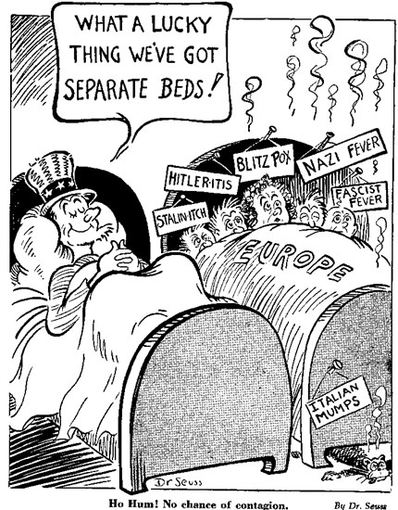

Slide 10
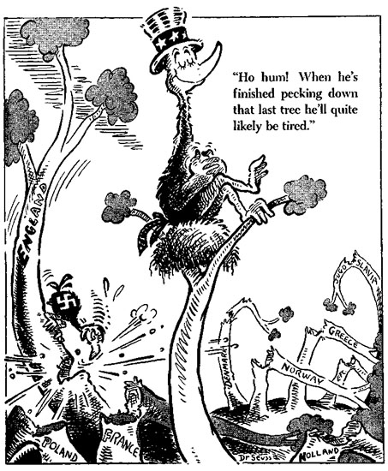

Slide 11
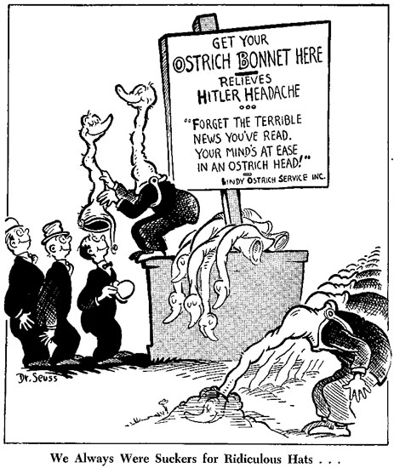

Slide 12
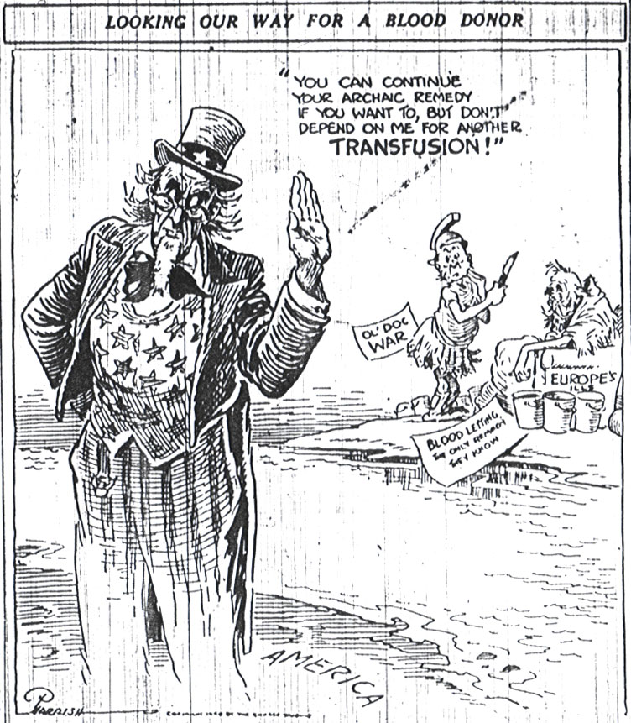

Slide 13
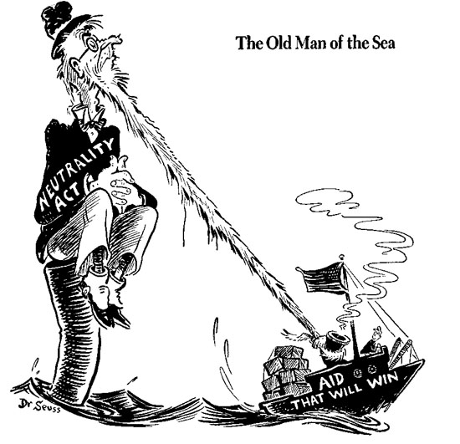

Slide 14
