Slide 1
Do Now: Grab a worksheet and write down what you think the message of the cartoon is.
Objectives: Students will be able to…(1) explain how the Marshall and Truman Plan impacted Berlin (2) transfer knowledge to an activity
Homework: Quiz on Chapter 26.1/26.2
(EXCEPT KOREAN WAR SECTION)

Slide 2
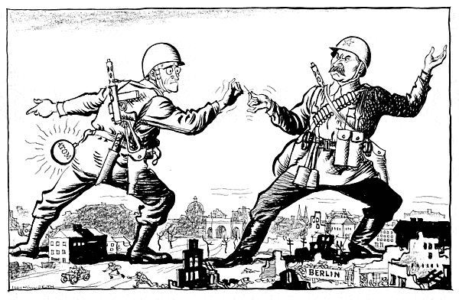
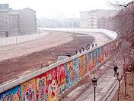
The Berlin Crisis
Early 1848 – US concludes Soviets deliberately trying to destroy German economy
RESPONSE: US, GB, France → Combine their zones
Called it – Federal Republic of Germany (aka West Germany)
Independent from Soviet Zone → couldn’t have military
No Military

Slide 3
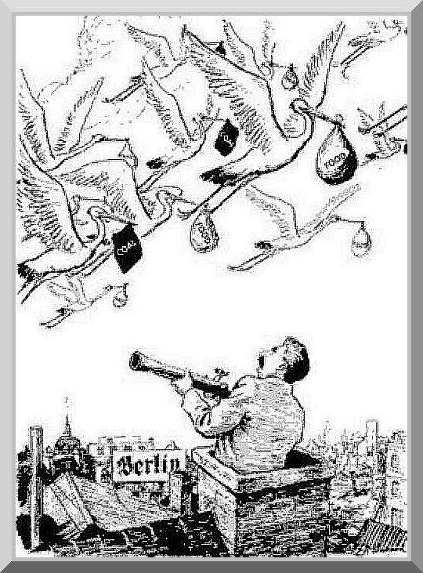
The Berlin Airlift
Soviets cut off road and rail traffic to West Germany
Truman sent atomic bombs to Britain
Couldn’t Budge…
Airlift – 11 Months of Cargo Planes bringing supplies
Food
Medicine
Coal
2 Million tons of supplies
May 12 Blockade lifted by Stalin
http://www.youtube.com/watch?v=_nHdB1vJNsg

Slide 4
NATO
North Atlantic Treaty Organization (NATO) – Mutual Defense Alliance
Treaty included US, Canada, Britain, France, Italy, Belgium, Denmark, Portugal, the Netherlands, Norway, Luxembourg, and Iceland
Purpose: Members agreed to come to the aid of any member who was attacked
Eventually let West Germany arm and join
Warsaw Pact – Soviet response (Alliance b/w East European Countries)

Slide 5
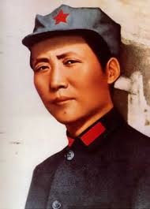
Civil War and Revolution in China
Mao Zedong – Led Communist rebellion against government
US Sent $2 Billion in aid, but it was squandered
1949 – Communists captured government
Nationalist fled to Taiwan
Established “People’s Republic of China”

Slide 6
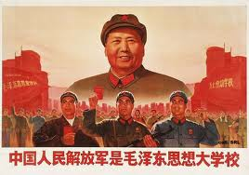
After the Fall…
China’s fall shocked US
Soviets successful test of Atomic Bomb
Soviets & China sign treaty of friendship and alliance
US kept diplomatic relations with Chinese nationalist, and used Veto power in the UN

Slide 7
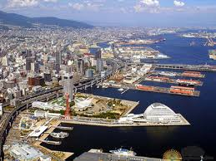
Change in policy towards Japan
End of WWII Gen. Douglas MacArthur was introducing democracy to Japan
Once China lost, US focused on rapid industrial recovery of Japan

Slide 8
Objectives: Students will be able to…(1) explain the Korean War (2) define limited war
Homework: Watch video link on website on Korean War (YouTube) video and answer the questions that go along with the documentary

Slide 9
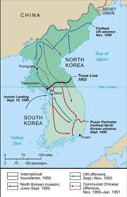
Korea
After WWII Soviets and Americans in Korea
Split at the 38th parallel
North – Soviet – Set up Communist Government
South – American – Set up Non-Communist Government
On June 25th, 1950 – North Korean troops invaded the South

Slide 10
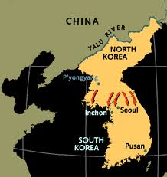
UN Intervention
Truman calls on UN to intervene (Test of Containment)
Successful because Soviets boycotting
With UN help, Truman orders MacArthur to send in US troops
US pushed back until daring attack

Slide 11
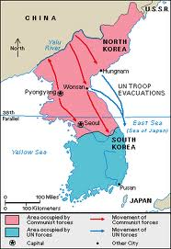
China Enters
Saw UN troops as a threat
Invaded over the Yalu River
MacArthur demands approval for war against China

Slide 12
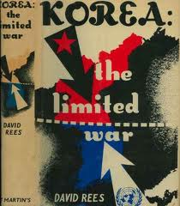
Truman Fires MacArthur
Truman denies MacArthur’s request
MacArthur publicly criticizes Truman
Truman fires him, but MacArthur remains popular
Truman committed to Limited War
War fought to achieve a limited objective
Containing Communism

Slide 13
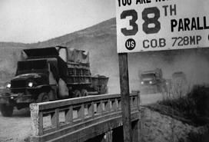
Korean War End
Became little scuffles
Peace treaty signed July 1953
35,000 died in the War
TURNING POINT IN COLD WAR
Switched from political pressure to major military backup

Slide 14
Homework
Watch documentary on Korean War posted on website for THURSDAY (45 Minutes)
Download worksheet and print/write or type/print out with the answers

