Slide 1
Do Now: Read “An American Story" on page 790. How does this story relate to the card building activity we did last week
Objectives: Students will be able to...(1) explain the Red Scare (2) identify key programs of conspiracies of the Red Scare era
Homework:
Finish One-Pager for FRIDAY
Notes on 26.3 for MONDAY

Slide 2
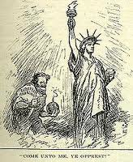
A New Red scare
Began with Igor Gouzenko in Canada
Escalated into fear of Communist subversion
Effort to secretly weaken society and overthrow it

Slide 3
The Loyalty Review Program
Program to screen all federal employees
6 Million screened
14,000 subject to intense scrutiny
2,000 quit
212 were fired for “questionable loyalty”

Slide 4
HUAC
J. Edgar Hoover –1st Director of FBI
Started FBI in 1935
Paranoid beyond belief
HUAC – House Un-American Activities Committee – Formed in 1938 to investigate Communist/Fascist activities
Hoover wanted public hearings
Reveal “The diabolic machinations of sinister figure engaged in un-American activities”
Open Communists to public isolation and expose sympathizers

Slide 6
Alger Hiss
Whittaker Chambers – Time magazine editor and former Commie
Testified that gov. officials were Commies
Alger Hiss – Lawyer/Diplomat – Accused by Chambers
Committee ready to drop, but Nixon convinced it to continue until liar was discovered
Chambers produced secret documents /microfilms hidden in hollow pumpkin – “Pumpkin Papers”
Perjury – lying under oath

Slide 7
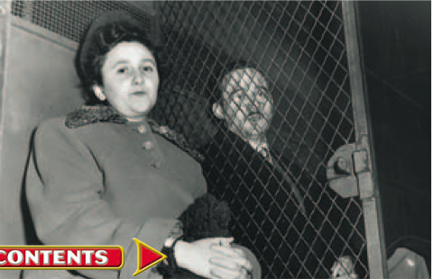
The Rosenbergs
Belief that Soviets had help developing A-Bomb
Hunt led to British Scientist
His testimony led FBI to Julius and Ethel Rosenberg

Slide 8
Project VeNona
Project “Venona” (1946) – Cracked Soviet code – Evidence of spying
Sent government on massive manhunt
Didn’t make public until 1995

Slide 9
Red Scare Spreads…
Univ. Calif. – Forced 11,000 loyalty oaths
157 fired who didn’t take oath
Catholic Churches urged to identify Commies
Taft-Hartley Act required union leaders to take oaths

Slide 10
“A Conspiracy so Immense”
1949- Red Scare was intense
Soviet had A-Bomb
China fell to Communism
People thought we were losing Cold War
Blamed spies/infiltration

Slide 11
Do nOw: Define Mccarthyism
Objectives: Students will be able to...
explain life during the Cold War Era
write from a chose perspective
Homework:
Notes on 26.4
Chapter 26 quiz on Wednesday

Slide 12
Joseph McCarthy
Wisconsin Senator
Gave political speech to women’s Republican group
Made a shocking claim:
“While I cannot take the time to name all the men in the State Department who have been named as members of the Communist Party and members of the spy ring, I have here in my hand a list of 205 that were known to the Secretary of State as being members of the Communist Party and who nevertheless are still working and shaping policy of the state department”
Never showed the list….

Slide 13
McCarthy’s Charges
Won Senator with fiery speeches and Communist accusations
Called Democrats “party of betrayal”
Accused George C. Marshall of disloyalty as a member of “a conspiracy so immense as to dwarf any previous such ventures in the history of man.”

Slide 14
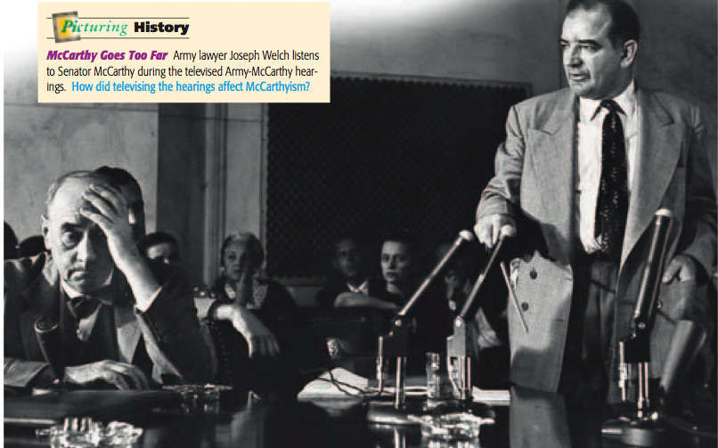
McCarthy's Tactics
After 1952 – Rep. had majority in Congress
McCarthy became senate subcommittee chairman
Started witch hunt
McCarthyism – damaging reputations with vague and unfounded charges

Slide 15
McCarthy’s Downfall
Began looking for spies in US Army
Army did own internal investigation
McCarthy took investigation to TV (Army-McCarthy hearings)
McCarthy brought up past of a lawyer in Welch’s (Army lawyer) firm
Member of Communist front organization during law school
Welch fires back! – “Have you no decency?”
Senate passed vote of Censure formal disapproval

Slide 16
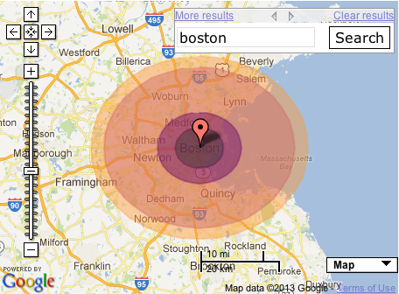
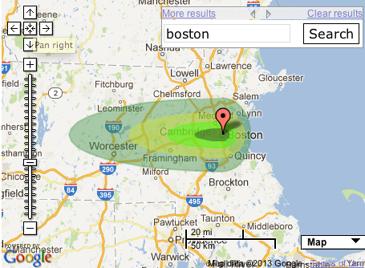
Nuclear Weapons
Soviet test changes EVERYTHING!
2nd- More powerful test (H-Bomb)
US Prepared for Soviet surprise attack
Schools had bomb shelters – “Duck and cover drills”
Experts – For every 1 person killed by nuclear blast – 4 would die later from fallout (radiation left over)
Families built fallout shelters stocked with canned food

Slide 17
DUCK AND COVER!!!!
http://www.youtube.com/watch?v=IKqXu-5jw60 (Serious US Documentary)
http://www.youtube.com/watch?v=q3vrkA6eoE0 (Best show ever mocking “duck and cover”

Slide 18
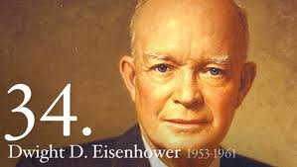
Eisenhower’s “New Look”
Eisenhower – Elected in 1952
Believed Truman’s policy wasn’t working
Soviets had A-bomb
Consolidated Eastern European hold
China Communist
American troops in Korean War
Republican – Defeated Adlai Stevenson (Democrat from Illinois)
Organized D-Day invasion

Slide 19
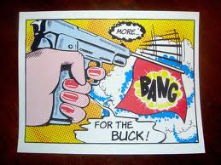
“More bang for the Buck”
Key to Winning – Not simply military, but strong economy
Show the world Free Enterprise made a better society
Prevent subversion
Scaled back army – Ramped up atomic weapons in all forms
A LOT OF YOU SAID THIS ABOUT DROPPING THE BOMB ON HIROSHIMA AND NAGASAKI! MAYBE YOU SHOULD BE PRESIDENTS?

Slide 20
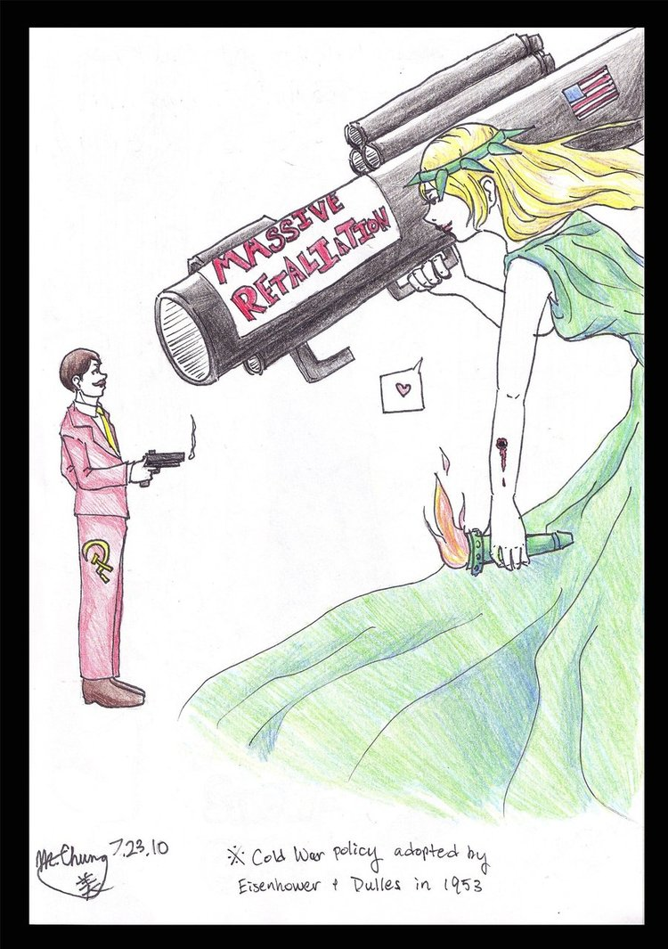
Massive Retaliation
Korean War – Showed couldn’t contain Comm. With small wars
Unpopular & Expensive
Prevent from happening in first place
Threaten use of Nukes if Commie nations tried to seize territory by force (Massive Retaliation)
Cut $50 bill. to $34 bill.
1,00 bombs (1953) – 18,000 bombs (1961)

Slide 21
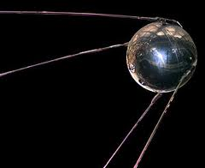
The Sputnik Crisis
New technology needed to deliver
B-52 – Travel across continents
ICBM’s (Intercontinental Ballistic Missiles)
Submarines
http://www.youtube.com/watch?v=GwHZsiDZzDU
Soviets launch Sputnik (Artificial Satellite)
1958 – NASA created (Nat. Aeronautics & Space Admin.)
National Defense Education Act (NDEA) – funds for education in math, science, and foreign language.

