Slide 1
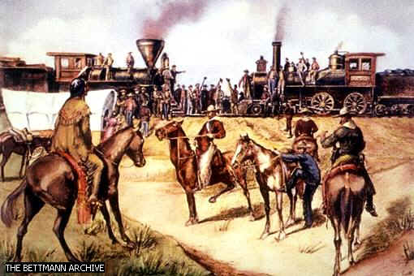
Do Now: Grab a paper and complete the ‘Do Now’
Objectives: Students will be able to...(1) explain westward expansion (2) analyze a PowerPoint for key information

Slide 2
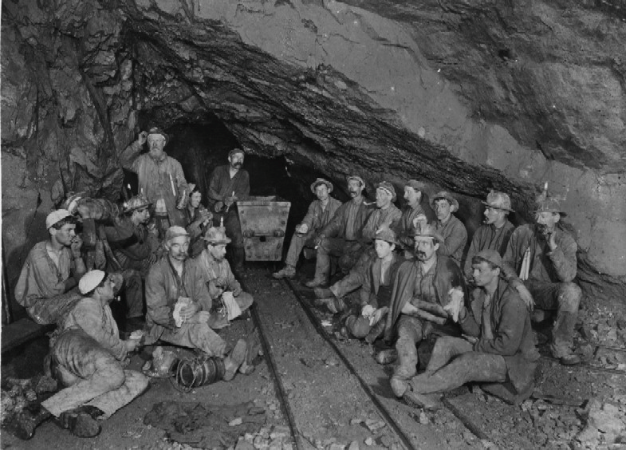
Moving West!!!!!
Mining was big
The west had: Gold, Silver, and Copper
Placer Mining – Using small equipment (Picks, shovels, pans)
Quartz Mining – Big deep below surfaces

Slide 3
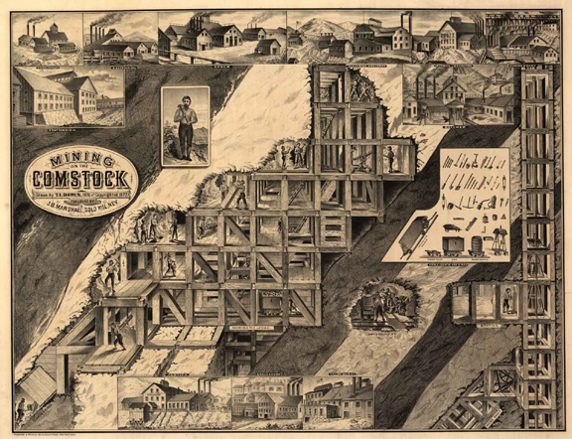
Big Strike in Nevada
Henry Comstock
Towns exploded with new discoveries
Boom to ghost towns
Huge increase in crime:
Prospectors fought over claims
Thieves roamed streets
Vigilance Committees: Tracked down wrongdoers
These towns popped up all over!

Slide 4
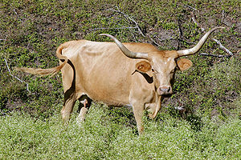
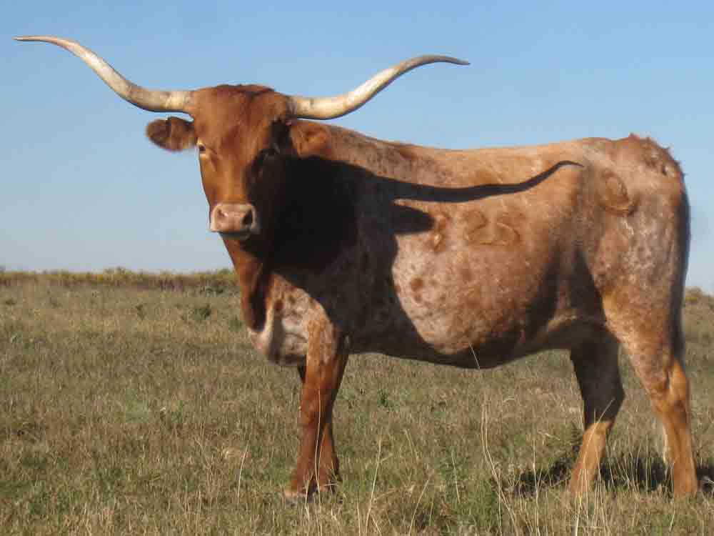
Ranching and Cattle Drives
Special Breed of Cattle in Texas (Longhorn)
Could survive bad conditions on plains
Open Range – vast area of grassland owned by government
After Civil War, more incentive for beef. 2 Reasons why:
Railroad
Needed food after war

Slide 5
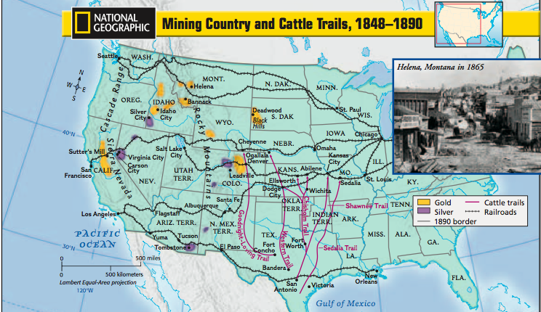
Cattle trails and railroads

Slide 6
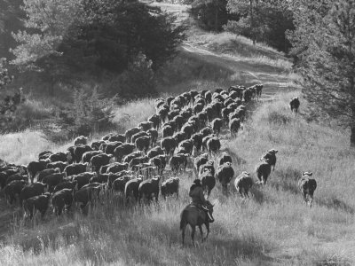
The Long Drive
Ranchers/Cowboys met to collect cattle from open range
Branded cattle so they knew who owned cattle
Mavericks: Stray cattle with no owners
2,000-5,000 cattle per herd
Guided them up to railroads
Stampede Video

Slide 7
Question…
You can now start taking the railroad out west
For $226 dollars would you take 100 acres of land in Nebraska?
What would you do once you got there?

Slide 8
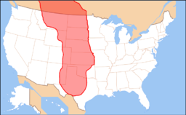
The Great Plains
Less than 20 inches of rain per year
Trees ONLY near rivers and streams
100 Degrees in summer
Prairie fires
Swarms of grasshoppers and locus
Blizzards and extreme cold in Winter

Slide 9
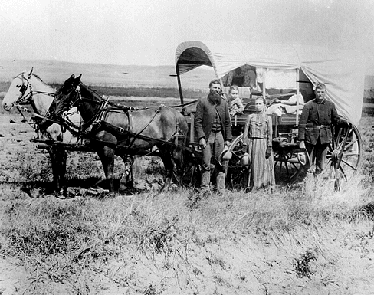
Homestead Act
For $10 registration fee ($250 today) you could get government land and title to land

Slide 10
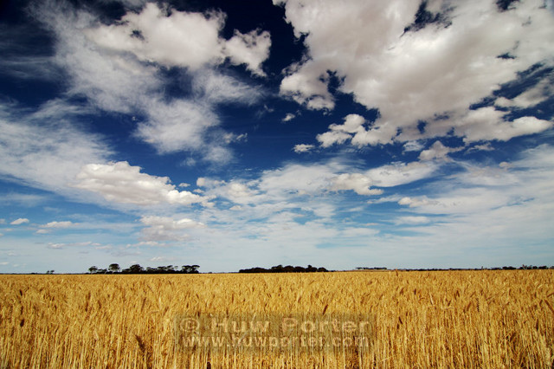
The Wheat Belt
You could make money if you had money! (Technology)
Dry farming – Plant seeds deep in ground where there’s moisture
New machines helped
Sodbusters – Those who plowed field in Great Plains
Bonanza Farms – HUGE 50,000 acre fields

Slide 11
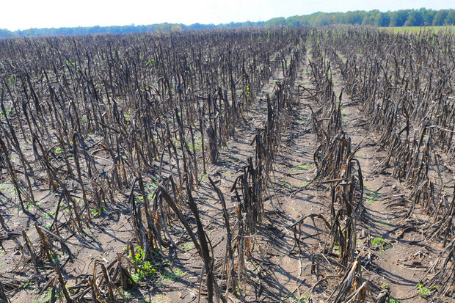
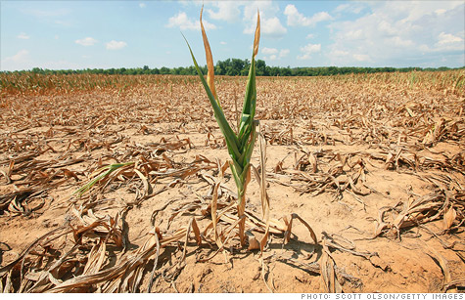
Sounds good, right?
Other countries started making Wheat
Long droughts hit – People lost farms
Many didn’t get rich
Most just got by….

