Slide 1
Do Now: Read “An American Story” and summarize in 3 sentences. (Make sure it’s good – I’m checking)
Objectives: Students will be able to... (1) explain westward expansion (2) identify key information from text.

Slide 2
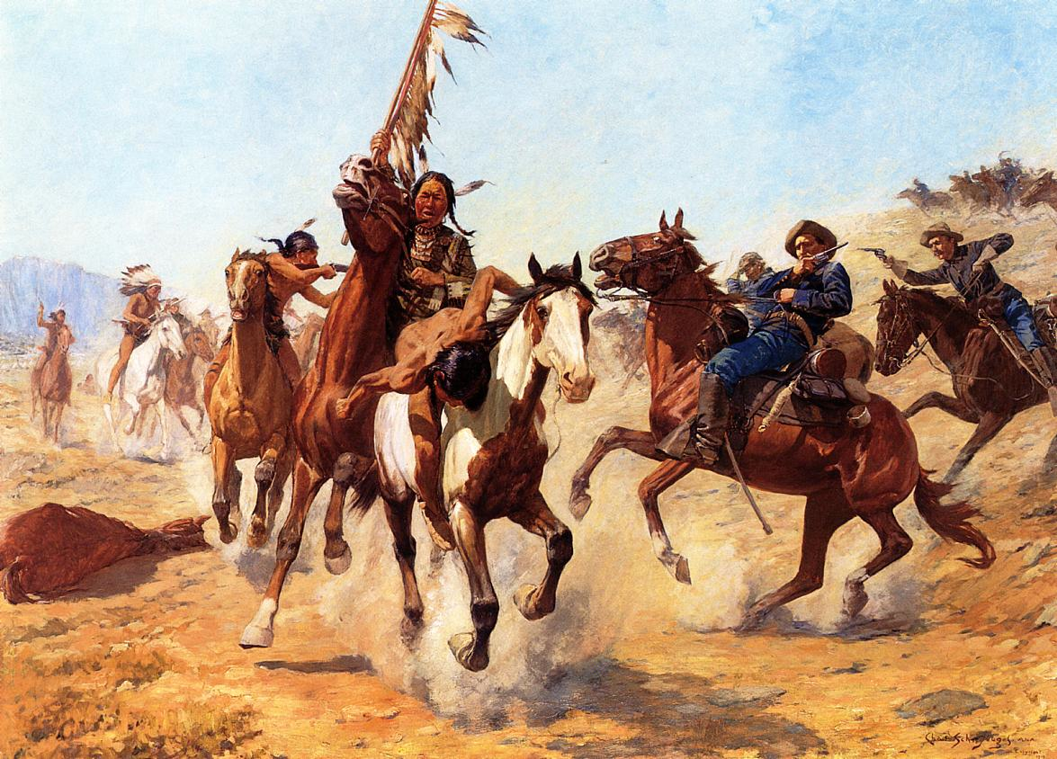
Culture of the Plains Indians
Many were nomads – moved around plains following foods
Really close with nature
500-2,000 people per tribe
Many battles with settlers

Slide 3
Twitter
Create a twitter handle that tweets out updates on the Native Americans – 2 Tweets from each section

