Slide 1
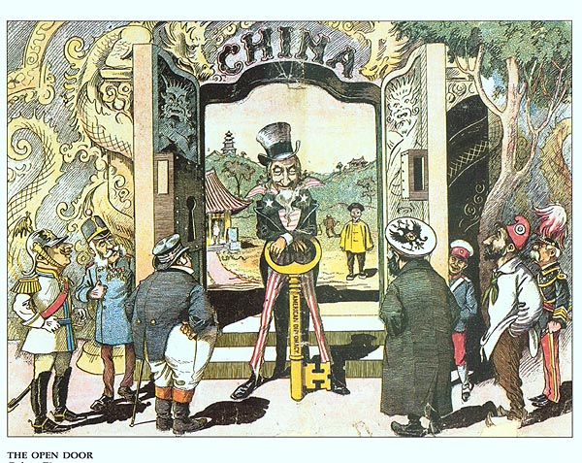
Do Now: 1. What are you bringing to finals? 2. I see/It Means on cartoon
Objectives: Students will be able to...(1) analyze a political cartoon for key information (2) describe the difficulty of building the Panama Canal
Homework:
CHAPTER 17 DUE MONDAY
TEST ON Chapter 16/17 MONDAY

Slide 2
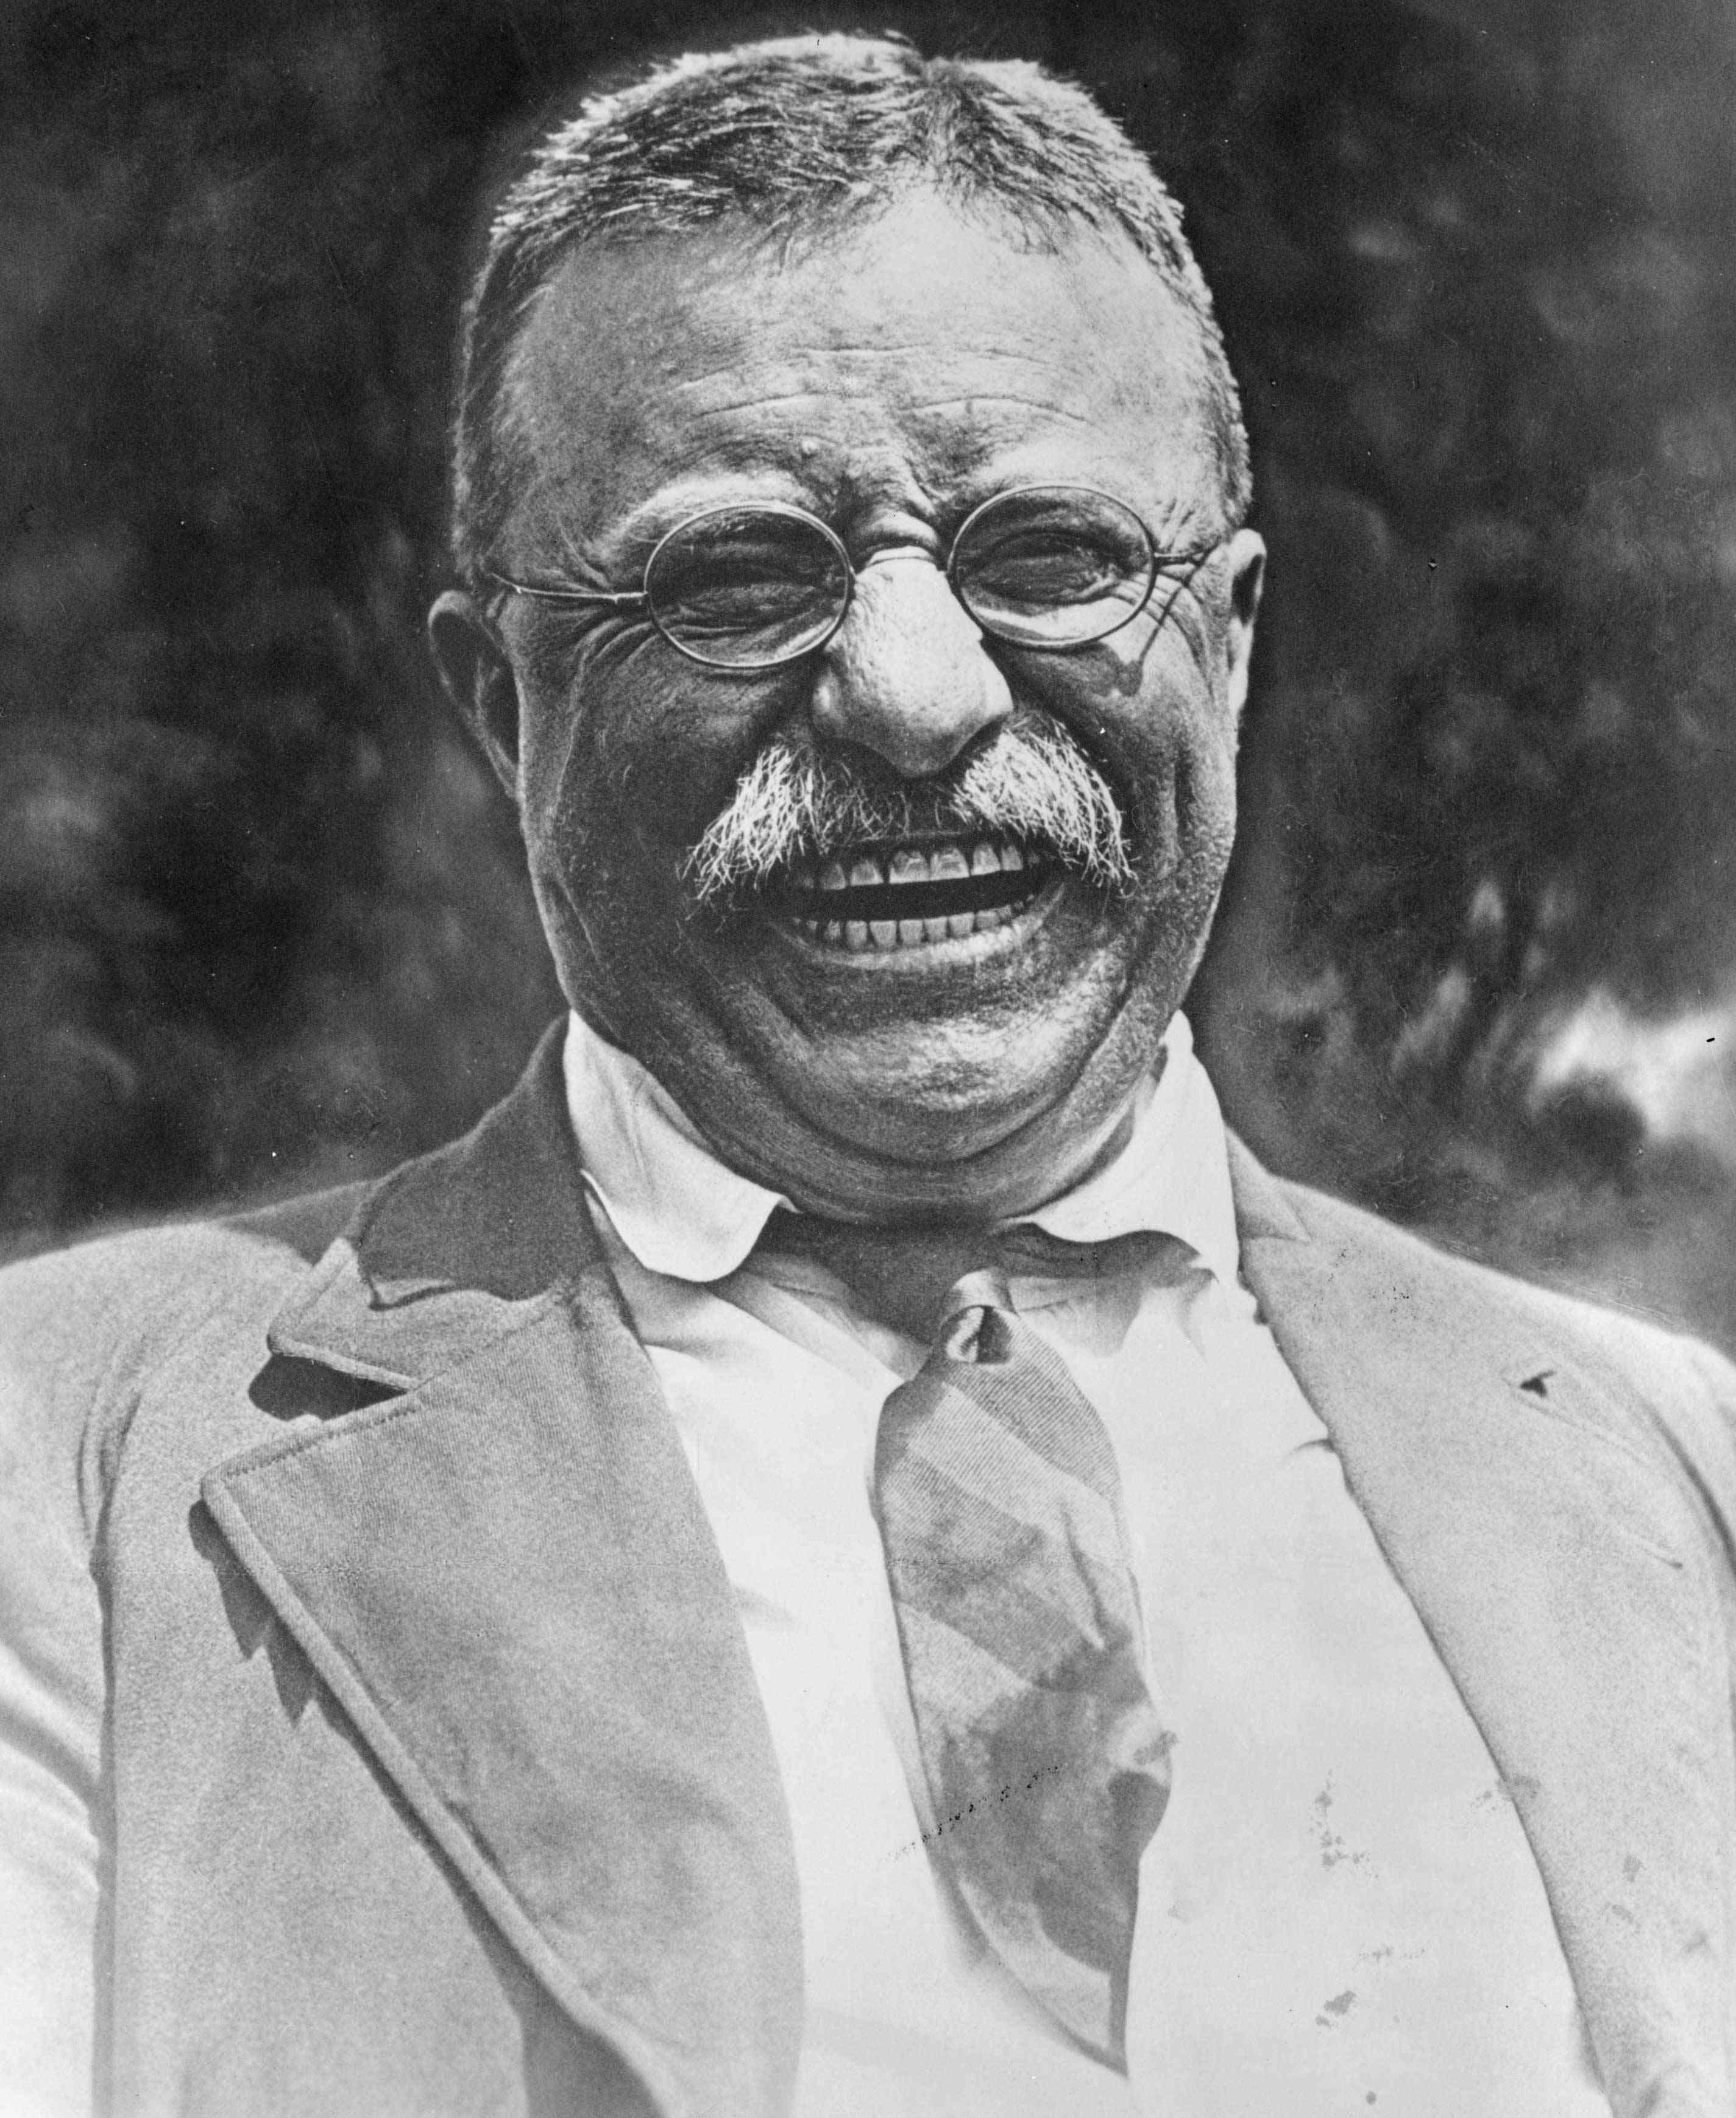
Roosevelt Becomes President
Brought energy/enthusiasm
Marksman/horseback rider
Wanted to get America power on world stage
Horseback rider and could row up to 20 miles a day
Believed in Anglo-saxonism

Slide 3
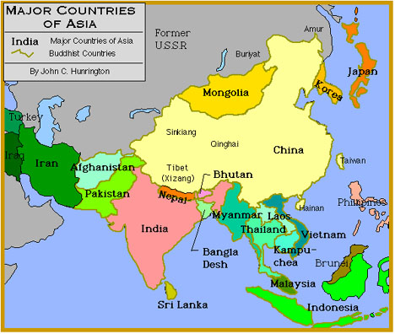
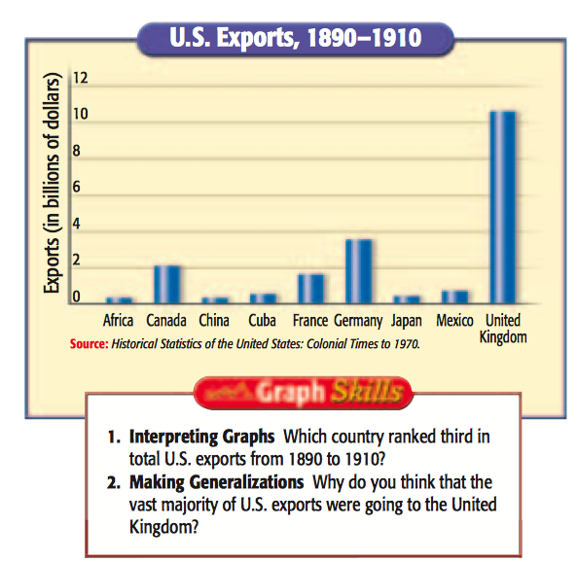
Diplomacy in Asia
Didn’t want to conquer → wanted to trade with
Set sights on China
Lots of people/customers

Slide 4
Open Door Policy
What does ‘leasing’ mean?
Read through this section on page 538 and make a timeline of events up to Boxer Rebellion section.

Slide 5
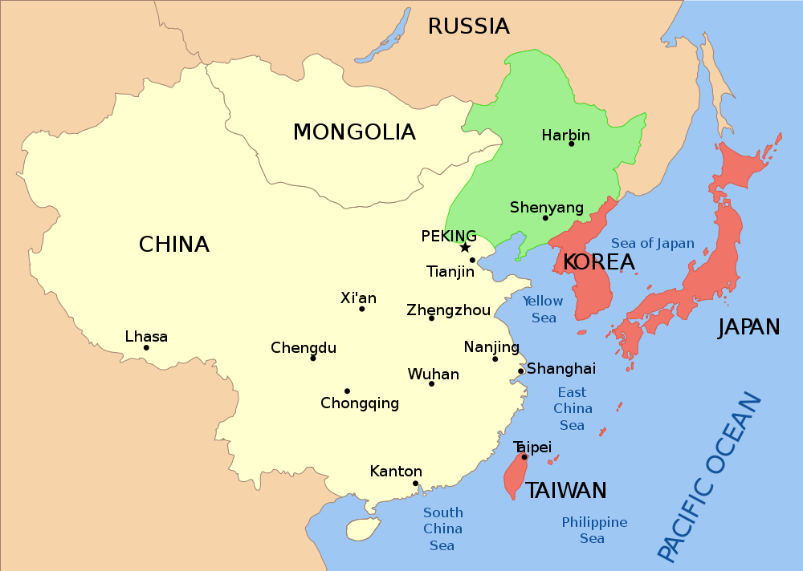
Open Door Policy
What two countries went to war over Korea?
Who proved to be the weaker country?
What did European countries start doing in China?
Why did this worry the United States?
What did the US want the great powers to do?

Slide 6
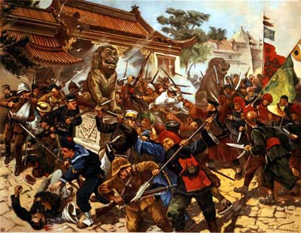
Boxer Rebellion
Secret societies forming in China to get rid of foreign powers
Group called “Christian Devils” started rebellion in capital → killed people/took prisoners
US fought to keep China together

Slide 7
Balancing Power in East Asia
Russia and Japan having problems
Teddy Roosevelt convinced them to stop fighting → won Nobel Peace Prize (1906)
Japan grows to dislike USA
“Great White Fleet” → Teddy sent 16 battleships from US Navy around the world to ‘Show off’
Went to Japan to demonstrate their power!

Slide 8
Panama Canal
How it works today…
Panama Canal (Time Lapse)

