Slide 1
Do Now: Make a list of your favorite TV shows, music artists, movies, game shows, etc.
Objectives: Students will be able to...(1) explain the culture of the 1950s (2) transfer knowledge to a mural

Slide 2
Homework: Guided worksheet 27.3

Slide 3
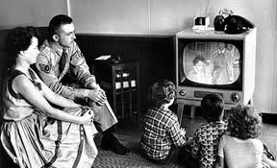
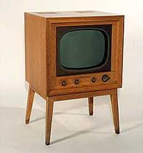
New Mass Media
Rise of TV
1946 – 8,000 Sets
1957 – 40 Million!
Ads, news, sports, shows
Action, Comedy, Game shows
20 Questions:
http://www.youtube.com/watch?v=gvGfOTOqRG4

Slide 4
Adapting the times
Tried to get back in the game after WWII
Cinemascope finally lured people
Reflected the times (Conformity)
Radio responded to TV with new programs
I Love Lucy:
http://www.youtube.com/watch?v=oM3L19hhvDA

Slide 5
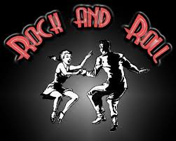
New Youth Culture
Some youth went against conformity
Rock ‘n’ Roll – Born in Cleveland
Alan Freed – Saw youth listening to AA music (Rhythm and Blues)
White artists started making similar music
Elvis Presley – “The Kind of Rock and Roll”
http://www.youtube.com/watch?v=unwE_632oh8

Slide 6
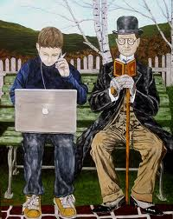
Generation Gap
Cultural separation between parents and kids
The beat movement – Beatniks – went against traditional culture
African American entertainers – Rise in popularity as well

Slide 7
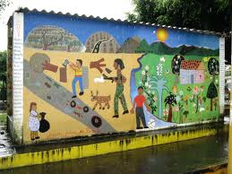
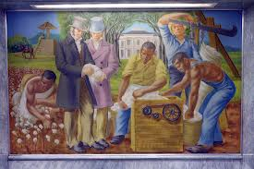
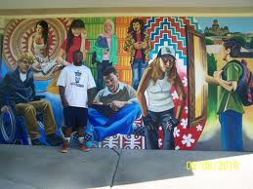
Your Task: Cultural Mural

Slide 8
Details
Overview: Working in groups of 4-5, you are going to create a mural/poster on culture and life in the 1950s
Be sure to touch on the MAJOR themes we’ve talked about”
Business
Consumerism
Technology
Medical
Space
Music & TV
Youth
Grading: This will count as TWO classwork grades in which I will be evaluating:
Participation amongst ALL members of the group & focus
Wide range of topics touched on in the mural
Be creative and make it look nice! You don’t have to be exceptional artists, but it shouldn’t be stick-figures

