Slide 1
Do Now: Get into a group of 5 people (No More, No less)
Homework: Notes on Chapter 26, Section 1 Due THURSDAY

Slide 2
Group Activity
Get into groups of 5 (People Sitting around you)
Mr. Collison will give each group a deck of cards and each PERSON an index card
On one card the term “RED” will be written
As a group, your GOAL is to build a house of cards as big as you can. (It’s a competition with the other groups)
If you have the index card that says “RED” you are trying to secretly sabotage the house without being noticed
In addition, the group is trying to figure out who the “RED” is…
We will do this for 7-10 minutes

Slide 3
Discussion
Keep the index cards underneath you…
Show of hands, who was accused of being RED?
How did it feel?
What was it like trying to figure out who the “RED” was?
What signs gave it away that they were “RED”?

Slide 4
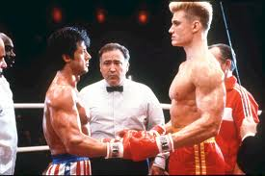
Cold War
Cold War (1946-1990) – Era of Hostilities between the US and Soviet Union following World War II
Named Cold War because each had Nuclear Weapons and threatened Mutually Assured Destruction

Slide 5
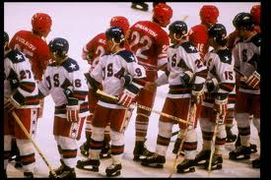
Differing Opinions
Both sides had different goals
Soviets – Keep Germany weak
Americans – Fix economies
Economics (Depression and WWII)
GD got worse b/c no trade (Forces War)

Slide 6
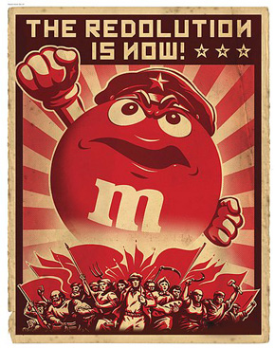
Red Scare
Fear that Communists were trying to take over the world
Thought they infiltrated the government
Began September 1945 with Igor Gouzenko

Slide 7
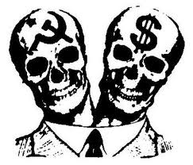
Communism vs. Capitalism Two Extremes
Communism | Capitalism
Society before individual No Private Ownership All resources are owned by ALL No Social Classes | Individualism Private Enterprises Every man earns his worth Social Classes

Slide 8
Pretty Much the Cold War….
http://www.youtube.com/watch?v=hU_8OLBK0ic
Scan Chapter 26 and write down things you’ve heard of before and want to learn

