Slide 1
Do Now: Grab a Worksheet and do the ‘Do Now’
Objectives: Students will be able to…(1) explain major events of the civil rights movement (2) identify key information from text
Homework: Keep working on projects
(DUE April 1)

Slide 2
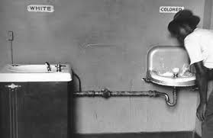
“Separate but Equal”
“Separate but Equal”

Slide 3
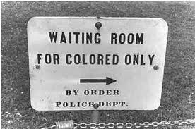

Slide 4
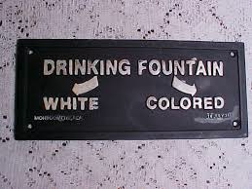

Slide 5
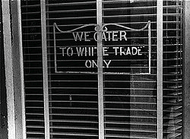

Slide 6
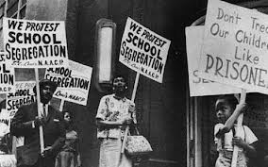
“Jim Crow” laws – Nickname for Segregation Laws

Slide 7
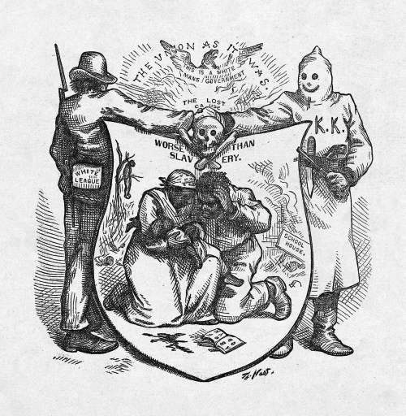
De facto segregation – Segregation by custom/tradition

Slide 8
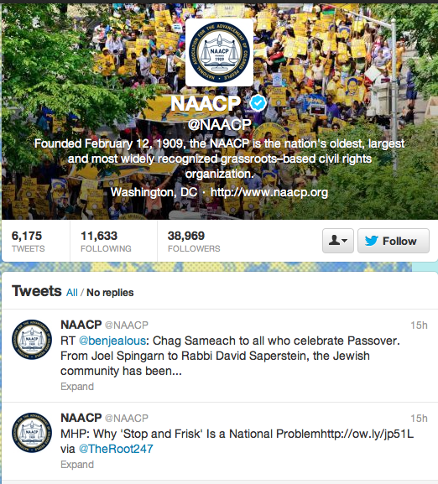
The Origins of the Movement
NAACP (National Association for Advancement of Colored People) – Supported Court Cases
More political power – Great Migration
CORE (Congress of Racial Equality) – Founded by James Farmer and George Houser
Used Sit-ins – a form of protest

Slide 9
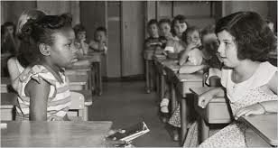
Brown vs. Board of Education
Thurgood Marshall – Chief Counsel/Director of legal defense and education fund for NAACP
Linda Brown – Denied access to school (Topeka Kansas)
Case reversed Plessy vs. Ferguson
https://www.youtube.com/watch?v=TTGHLdr-iak

Slide 10
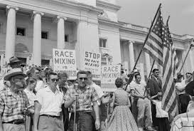
Southern Manifesto
“Massive Resistance” against desegregation
Abused Supreme Court Ruling – “with deliberate speed”
Southern Manifesto – 99 Southern Members of Congress Signed
Pledge to use “all lawful means” to reverse decision

Slide 11
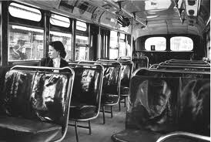
Montgomery Bus Boycotts
Spawned from Rosa Parks incident
Boycott organized of busses in Montgomery, Alabama
Martin Luther King Jr. (26) – Put in charge

Slide 12
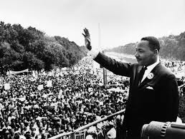
Martin Luther King Jr.
Pastor
Believed in Non-Violent protests (Crucial)
Who did he draw on for this notion?
Part of SCLC (Southern Christian Leadership Conference) – Collection of churches that helped fight segregation

Slide 13
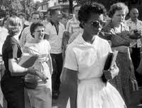
Crisis In Little Rock
Eisenhower – sympathized with civil rights
Disagreed with protests and court rulings (Needed to be Natural)
Thought it would lead to violence and splitting of country
Civil Rights Act 1957 – Impacted voting discrimination
http://www.youtube.com/watch?v=oodolEmUg2g (Little Rock Nine)

Slide 14
Final Discussion Questions

