Slide 1
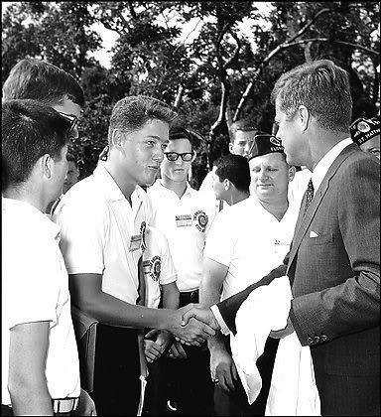
Do Now: With a partner make a list of major events from the video on Clinton’s presidency.
Objectives: Students will be able to...(1) outline a paper on Bill Clinton's presidency (2) explain the important events of Clinton's presidency.
Homework:
Notes 34.3
Two page paper DUE WEDNESDAY
I WOULD ALSO READ 34.2 IF I WERE YOU

Slide 2
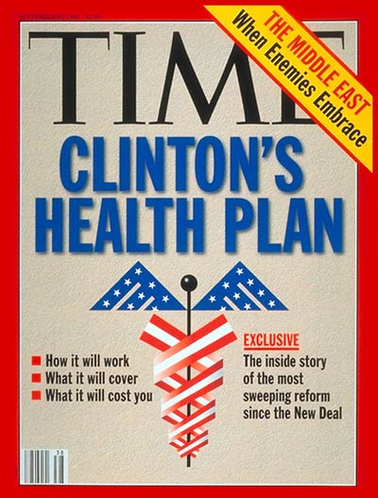
First Term Agenda
Raise Taxes, cutting spending:
Lower interest rates
A lot of $$$ going to entitlement programs
Health Care (Hilary Clinton):
Came up with plan that guaranteed health benefits
Plan died
Families and Education:
Family Medical Leave Act
AmeriCorps
Gun Control
Brady Bill – Waiting period for handguns

Slide 3
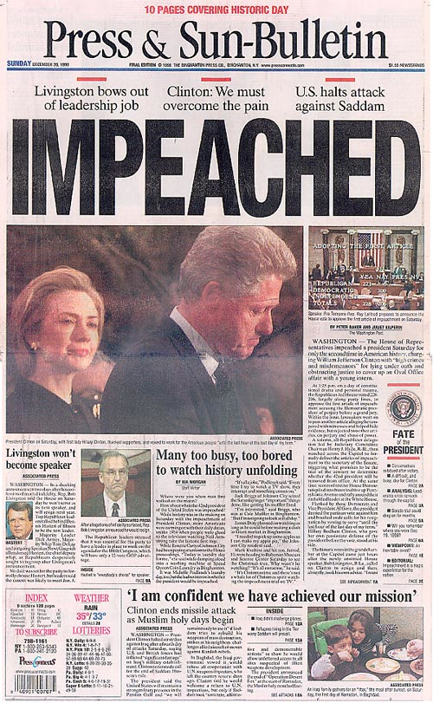
Clinton’s Second Term
Tried to help nations children
Impeachment:
Attorney General (Janet Reno) – Decided to investigate
Kenneth Star – Led Panel
Evidence suggested perjury – lying under oath
Was not booted out of office

Slide 4
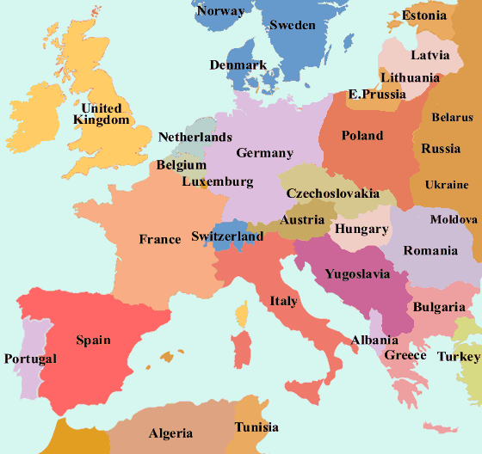
Foreign Policies
Bosnia and Kosovo
Yugoslavia split (Southeast Europe)
3-way civil war (Serbians, Croatians, and Bosnian Muslims)
Serbs started Ethnic Cleansing – expulsion of ethnic groups from area
Dayton Accords – Peace talks in Dayton Ohio
http://www.youtube.com/watch?v=VbNocQORWQ8 (BBC)

Slide 5
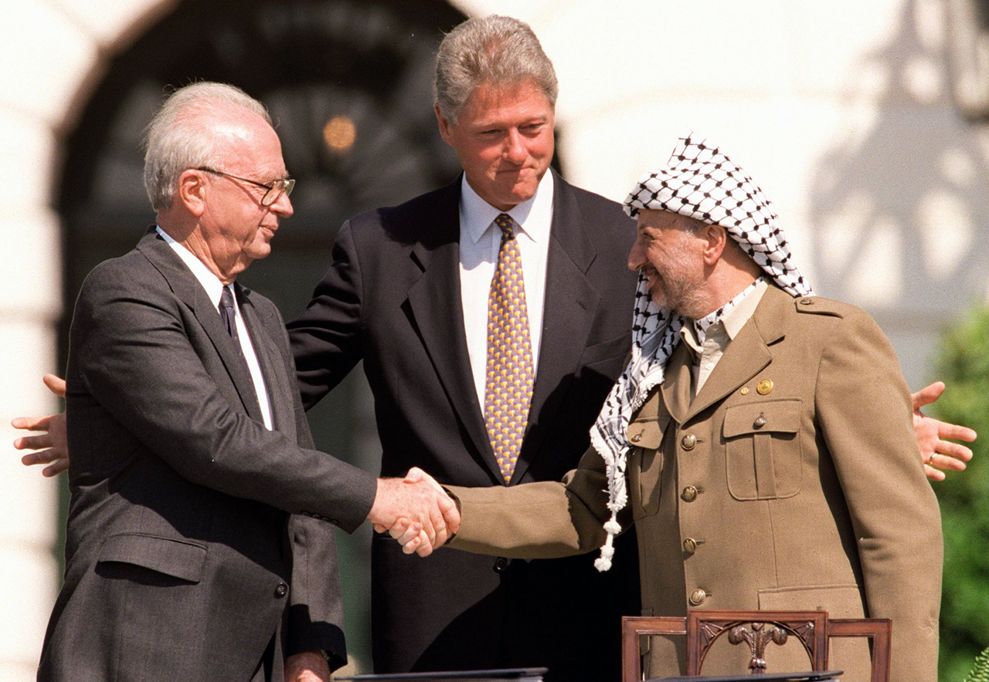
Middle East
Israel vs. Palestine
Israel Leader – Yitzhak Rabin
Palestine Leader – Yasir Arafat
Agreement
Palestine recognized Israel as country
Israel recognizes Palestine Liberation Organization
Further peace plans attempted but too much opposition

Slide 6
Partner Outline
Begin outlining your paper that’s due on Wednesday
Be sure you:
Organize your thoughts
ATQ
Use specific evidence

