Slide 1
Do Now: Grab a survey and answer the questions.
Objectives: Students will be able to...(1) define liberals and conservatives (2) analyze the characteristics of both.

Slide 2
Fill in your Liberal & Conservative Chart
Page 981
List things they believe or support

Slide 3
Liberalism vs. Conservatism Dominated much of 1900s
Liberals | Conservatives
Government should regulate economy Protection from big businesses Government (Federal) should help disadvantaged Americans Social programs Tax burden on wealthy Government SHOULDN’T regulate social behavior Pro free speech and privacy Government should not support religion Support high taxes of wealthy | Distrust powerful government Economic: Less government intervention Does not regulate economy (Free Enterprise) Oppose high taxes Support strong military Religious faith really important to society Social problems are issue of morality Government can use some police force to regulate social behaviors

Slide 4
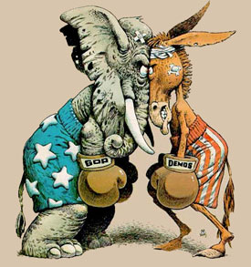
Lets try and see if we can figure some out…
Who would agree with the following statements?
Hold up your sign…

Slide 5
“The government should run healthcare”

Slide 7
The government should spend less in order to stay within budget rather than increase taxes on citizens to balance the budget.

Slide 9
The government should force businesses to provide certain benefits to employees.

Slide 11
People only become wealthy by hurting others.

Slide 13
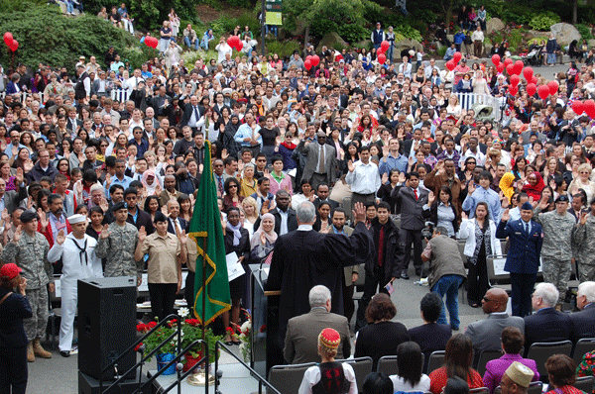
Private citizens can do most things better than the government.

Slide 15
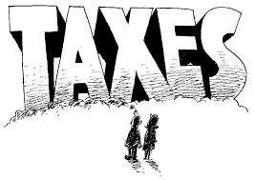
Increasing taxes paid by Americans will help the economy.

Slide 17
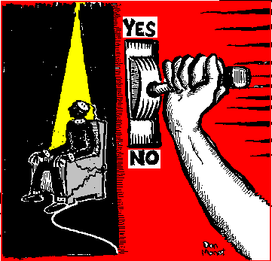
The death penalty should be used to protect society from repeat murderers.

Slide 19
The government should force businesses to hire a certain gender.

Slide 21
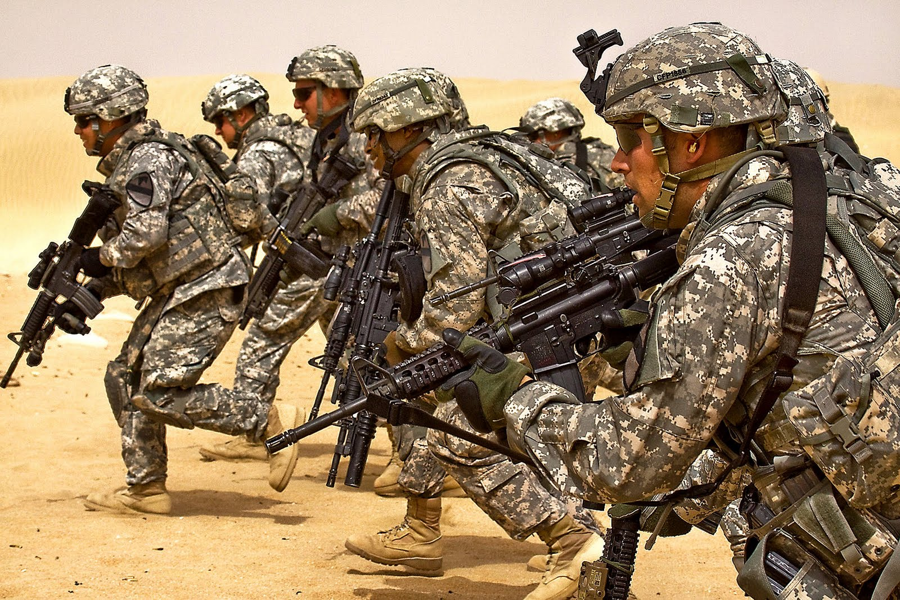
Most likely to support military intervention to bring terrorists to justice

Slide 23
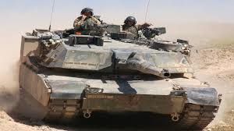
America should have a large and powerful military.

Slide 25
Your turn…
Taking the answer to your survey, explain in one sentence whether your answer is liberal or conservative and why.

Slide 26
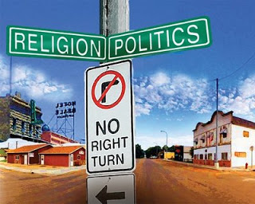
Conservatism and the Cold War
Revived for two major reasons:
Fights vs. Communism revived debate about role of government
Failed to stop spread of Communism because liberals didn't’t understand strong foreign policy
Communism rejects religion
Liberals lost support of religious Americans

Slide 27
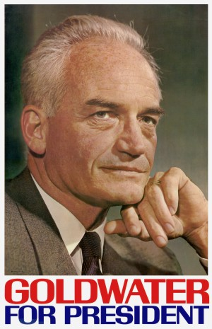
Conservatives Organize
William Buckley – Starts magazine National Review.
Young conservatives within Republican party pushed for bigger roles
Barry Goldwater – Even won nomination in 1964 (Lost to LBJ)

Slide 28
Do Now: Grab a map and label the the 48 continental states w/ a partner (Without a book)
Objectives: Students will be able to...(1) identify the sunbelt states (2) explain some characteristics of sunbelt states
Homework: Guided reading worksheet OR notes on 33.1

Slide 29
Sunbelt States (Shade or color in the following states)
California
Nevada
Arizona
New Mexico
Texas
Louisiana
Arkansas
Mississippi
Alabama
Tennessee
Georgia
Florida
South Carolina
North Carolina
Virginia

Slide 30
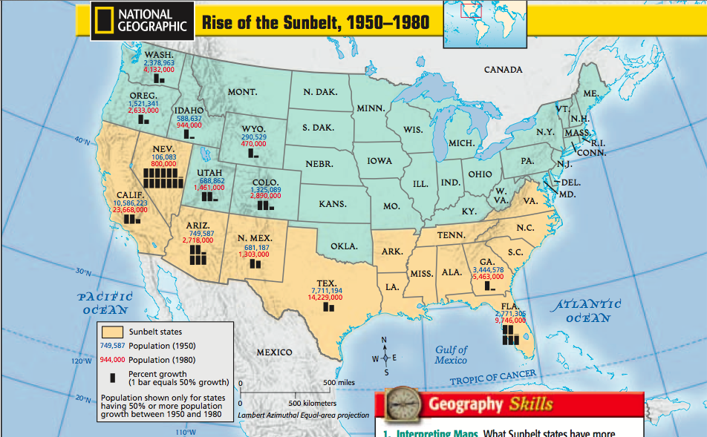

Slide 31
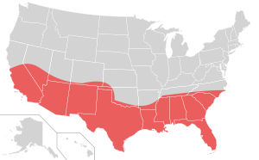
Rise of the Sunbelt
Historically – Conservatives split their vote (South – Democrats: West – Republicans)
Whoever won Northeast won election
Movement to South/West after WWII (Sunbelt)
People viewed federal government differently

Slide 32
Group Activity (pg. 982-984)
Questions to consider:
Why were these groups of people turning towards conservatism?
What did they oppose and why?
What gave these groups power?

