Slide 1
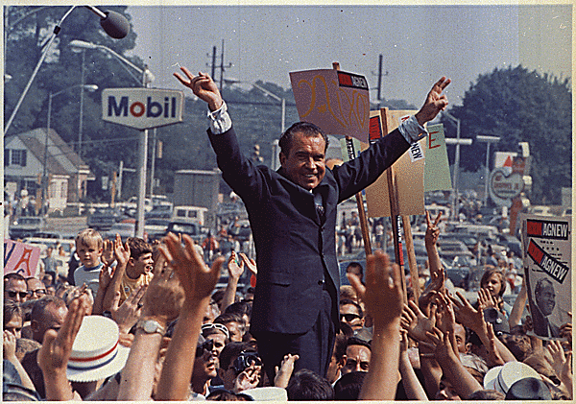
Do Now: Describe the opposition to Vietnam War after Tet and towards the end of the war? What was it like? (Violent, calm, aggressive, anti-US?)
Objectives: Students will be able to...(1) explain Nixon's domestic policies (2) analyze a video for key information
Homework: Read and summarize each paragraph from handout in one sentence.

Slide 2
Democratic National Convention – Chicago 1968
http://www.youtube.com/watch?v=aUKzSsVmnpY

Slide 3
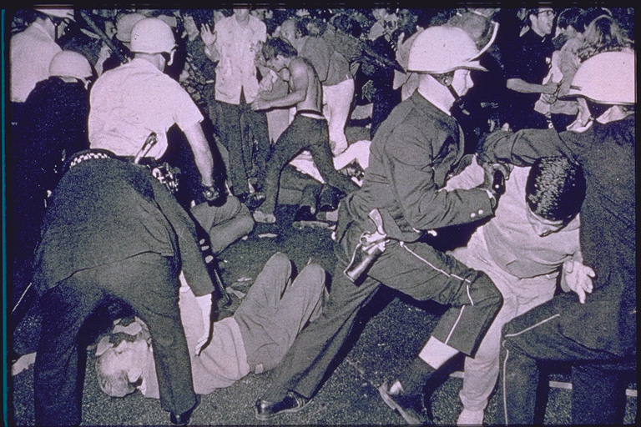
Briefly read through “An American Story” on page 952 and discuss questions below please ☺.
How did G.L. Halbert feel about the protesters in Chicago (The ones from the video)?
What about the police response?
Do you think his views were common or uncommon among most Americans?

Slide 4
The “Silent Majority”
Many supported the government and wanted end to war
Nixon appealed to frustration in America (60’s violence)
Nixon promised “peace with honor” in Vietnam

Slide 5
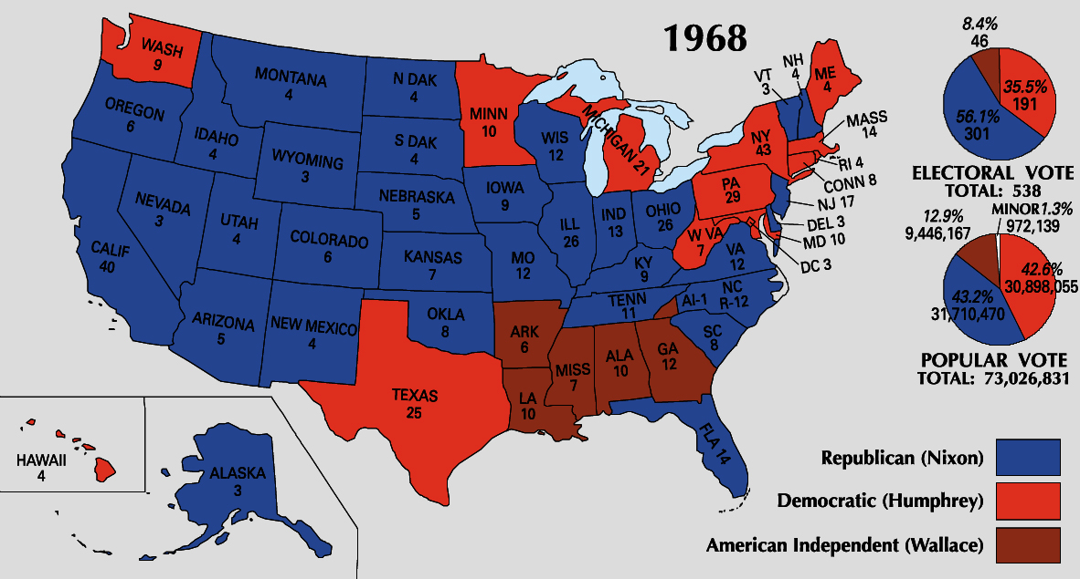
Election of 1968
Republican – Richard Nixon
Democrat – Hubert Humphrey
Third-Party – George Wallace

Slide 6
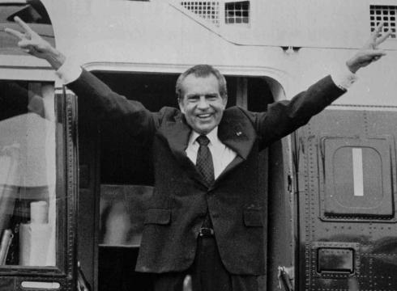
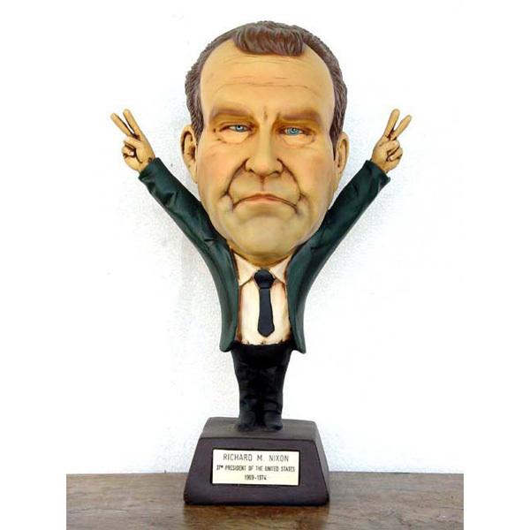
Winner!!!#$@!# Richard Nixon
http://www.youtube.com/watch?v=e9kraz6SQ60

Slide 7
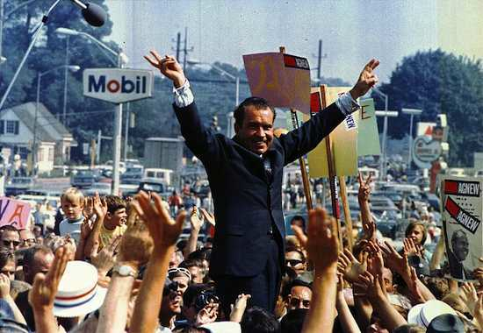
The Southern Strategy
Didn’t give up on South
Nixon made promises with Strom Thurmond (SC Senator)
Appointment of officials
No busing
Acceptable VP
Made good later on in presidency

Slide 8
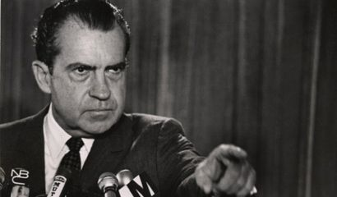
Law-and-Order President
Cracked down on crime
Stronger enforcement
Earl Warren (Retired) – Replaced by Warren Burger
Halted further rights for criminals

Slide 9
Federalism Principles
What is Federalism? What are some pros and cons?
What is revenue?
How is it distributed?
Balance of power b/w state and federal

Slide 10
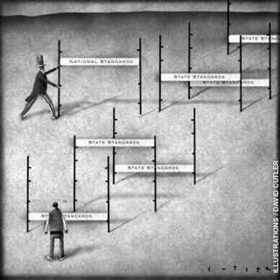
Nixon’s New Federalism
Dismantle federal programs and giving more power to states
Revenue Sharing – money brought in shared
Wanted more executive power
Tried to work around lawmakers
Impounded – Refusal to release funds

Slide 11
Do Now: Share your homework from last night. Similarities/Differences in summaries.
Objectives: Students will be able to...(1) analyze an image for key information (2) write from a chose perspective.
Homework: Finish profile

Slide 12
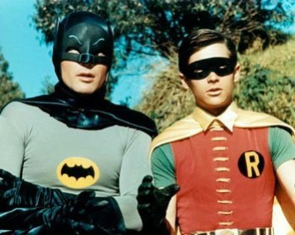
Nixon and Kissinger
Kissinger chosen as National Security Advisor
Can’t just abandon Vietnam. Why?
Gradual withdrawal
Thought previous policies too rigid (hard)
Negotiations key

Slide 13
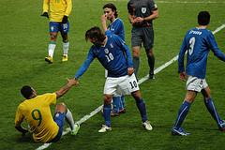
Fighting Groups of Friends
How to become friends again?
What will becoming friends again show the rest of the group?

Slide 14
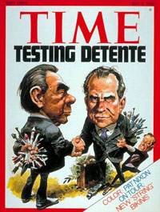
Détente - Relaxation of tensions
“We must understand that détente is not a love fest. It is an understanding between nations that have opposite purposes, but which share common interests, including the avoidance of nuclear war. Such an understanding can work – that is, restrain aggression and deter war – only as long as the potential aggressor is made to recognize that neither aggression nor war will be profitable”

Slide 15
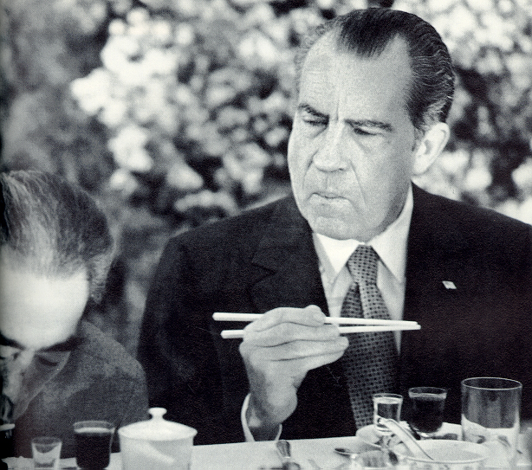
Nixon Visits China
Feb 1972 – Nixon announces visit
“More normal” relations
Goals of trip:
Strengthen ties with China
Encourage Soviets to pursue diplomacy
http://www.youtube.com/watch?v=N5V9sP_nDCM

Slide 16
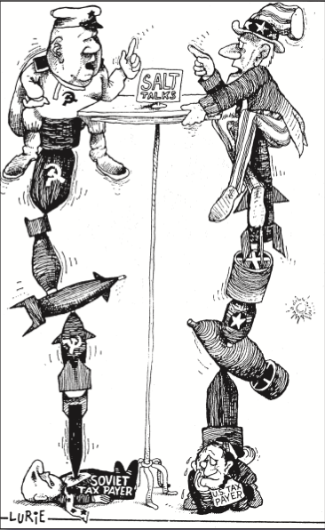
US-Soviet Tensions Ease
Summit – high-level negotiation
Pre-visit story
DO AN I SEE/IT MEANS CHART ON IMAGE

Slide 17
Facebook Profile - Nixon
Use 32.1 and handout I gave you
Domestic/Foreign Policy
Timeline of key events
Posts from other people
Profile picture

