Slide 1
Do Now: 1. What are you not forgetting for Finals? 2. What South American Country does Spain control that the US has interest in? 3. Why does the US want to help this country?
Objectives: Students will be able to...(1) analyze primary sources for key information about the USS Maine (2) Explain what happened to the Maine
Homework:
All of 17 DUE MONDAY
2. TEST CHAPTER 16/17 MONDAY

Slide 2
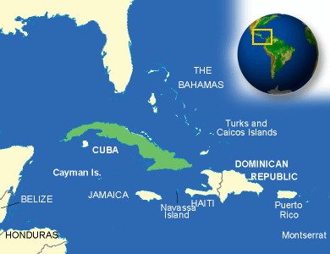
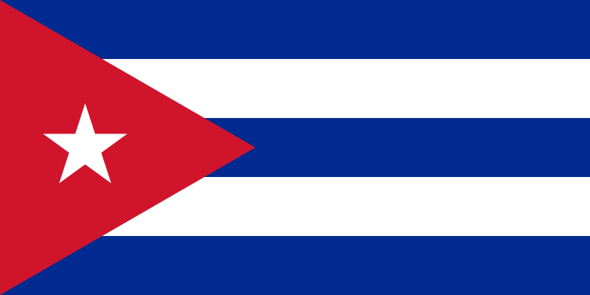
Cuba
Cuba → One of Spain’s oldest colonies
Sugarcane (1/3 of World’s sugar)
Cubans tried rebellion in 1868 → Failed → Fled to US and planned
Jose Marti – Exiled leader in NYC, planning another rebellion
USA and Cuba connected → Sugar and investments Cuba (mines, railroads, plantations)

Slide 3
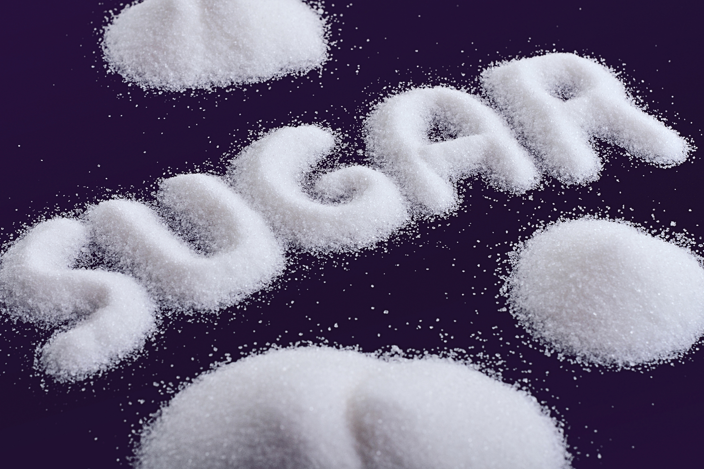
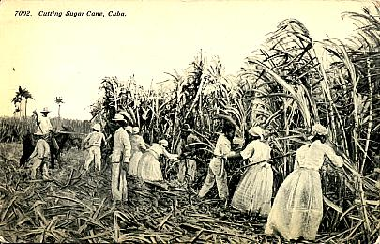
America Supports Cuba
US started neutral
Yellow Journalism – Exaggerated or even made up stories in newspaper to attract readers
Spain was brutal to Cubans
Cubans fought Guerilla War

Slide 4
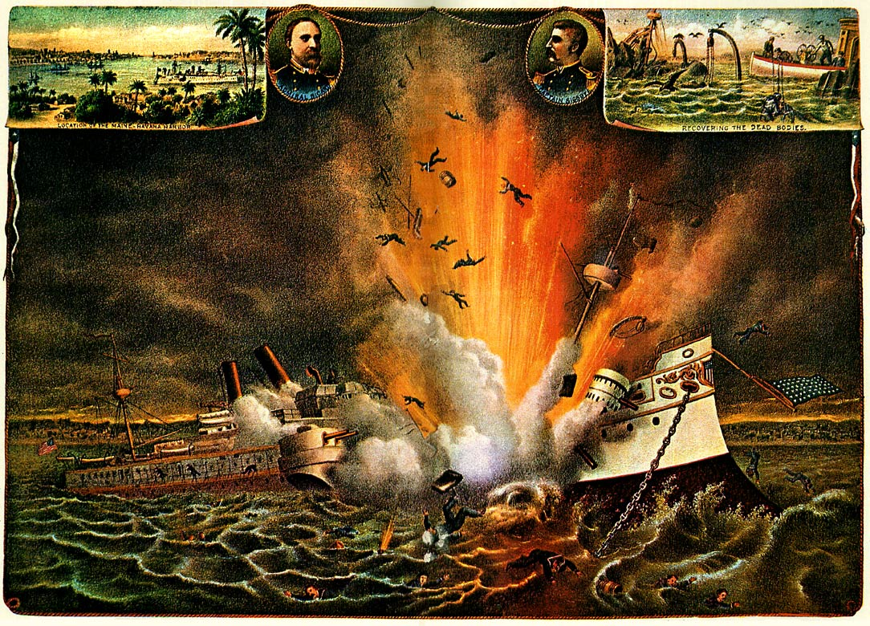
Americans Want War!!!!!!!
McKinley takes over as President – doesn’t want to intervene in revolution
Sends ship, USS Maine, to Havana harbor to protect US interests
USS Maine EXPLODES!
The press blames Spain → Congress UNANIMOUSLY approves war

Slide 5
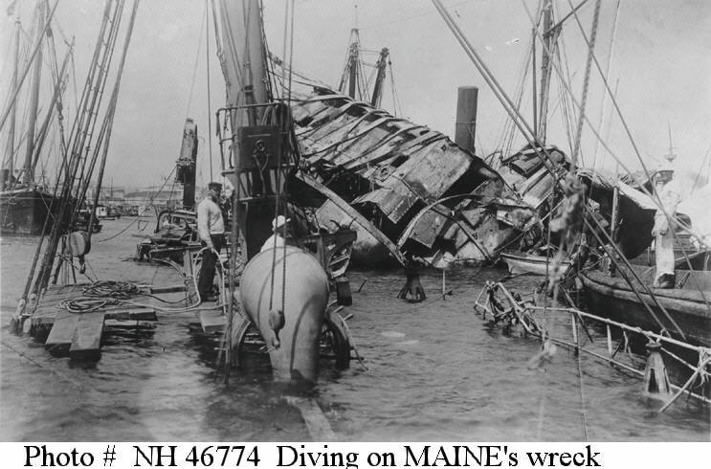
USS Maine Activity

Slide 6
Do Now: 1. What are you bringing to finals? 2. What happened to the USS Maine, and how did it lead the US to war? 3. Answer the map skills questions on page 530.
Objectives: Students will be able to...(1) create a timeline of major events in the war (2) explain the Spanish-American War
Homework:
Chapter 17 DUE MONDAY
TEST ON 16/17 Monday

Slide 7
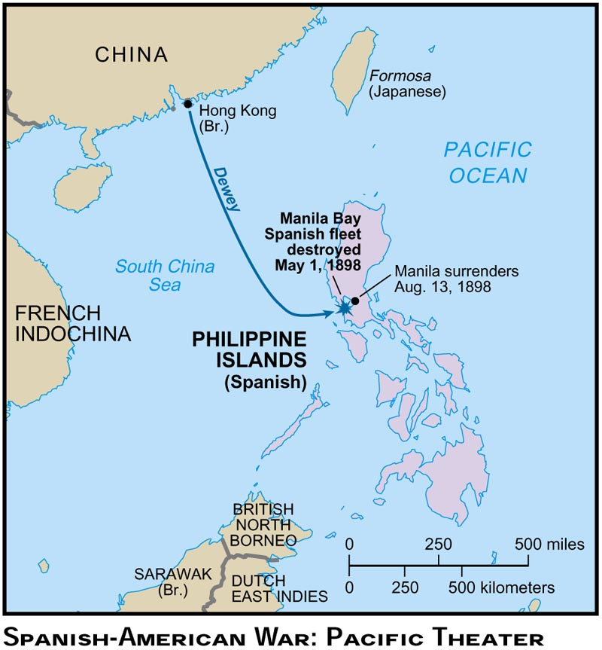
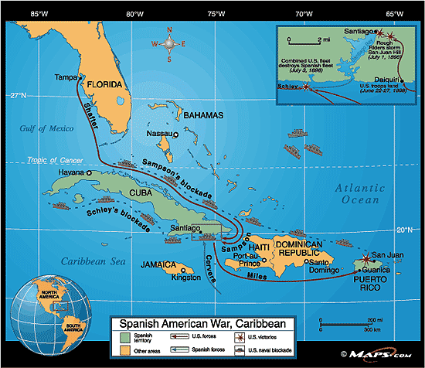
Two Front War

Slide 8
Create a Timeline of Major Events
You must have 15 events on your timeline, with pictures

