Slide 1
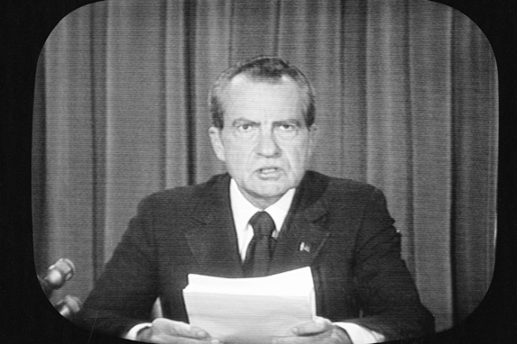
Do Now: Would you want the president impeached/arrested if they were involved in a cover-up? Why or why not?
Objectives: Students will be able to...(1) explain the Watergate scandal (2) work collaboratively.

Slide 2
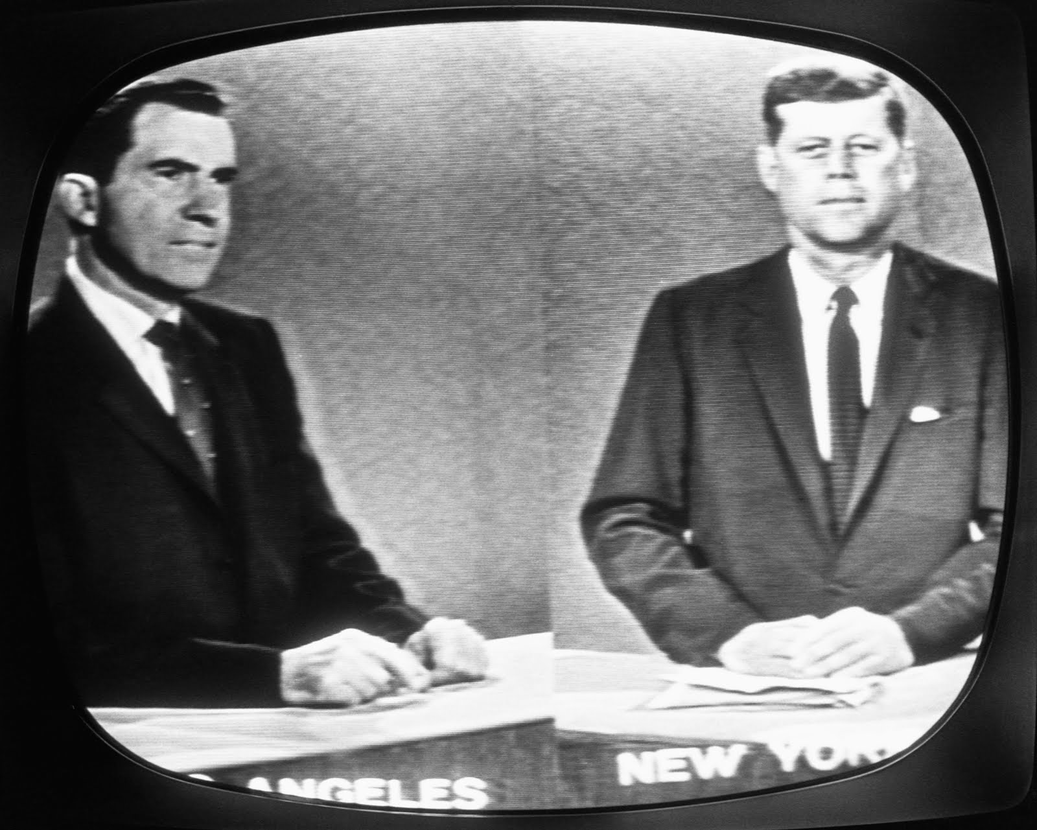
Nixon and His “Enemies”
Political battles throughout career
US at war with itself
Had an “Enemies List”

Slide 3
Re-Election Tactics
Subversive Tactics:
Broke into Democratic National Committee to steal secrets
Spying on rallies
False rumors

Slide 4
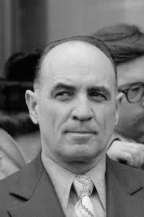
Cover-Up Begins
James McCord (Ex-CIA & CRP) – Burglar
Break-in funded by CRP
Nixon ordered Cover-up
Nixon continued to deny

Slide 5
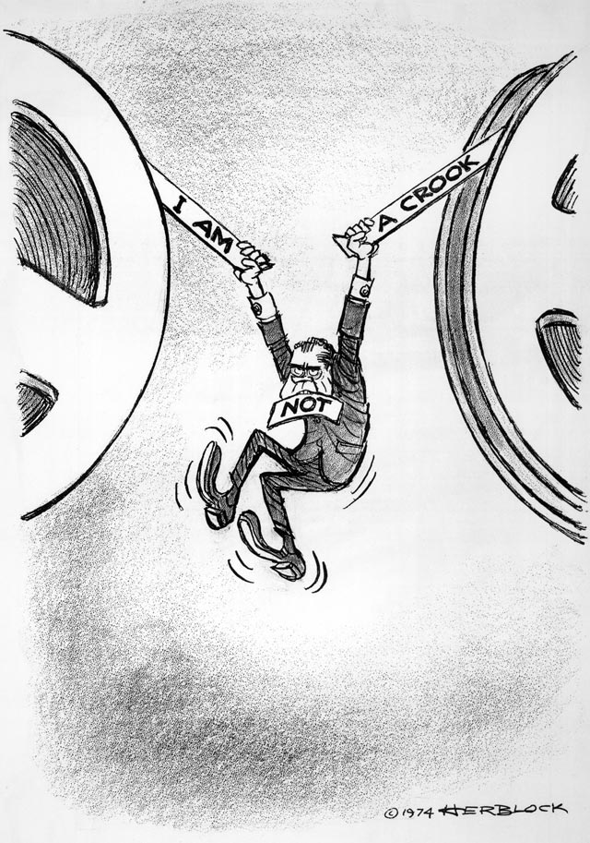
The Cover-Up Unravels
Questioning begins
Sam Ervin – NC Senator (Head of senate committee investigating)
John Dean – Member of inner circle who testified and made allegations towards Nixon
Alex Butterfield (Deputy Assistant) Testified about taping system

Slide 6
The Case of the Tapes
Nixon refused to give tapes
Executive Privilege – Principle that White House conversations should remain confidential to protect national security
Archibald Cox – Prosecutor took Nixon to court (“Saturday Night Massacre”
Nixon ordered Attorney General and Deputy to fire him (They refused and resigned)
Next in line, Robert Bork, finally fired Cox

Slide 7
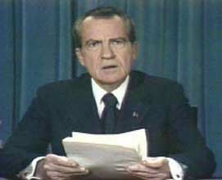
Nixon Resigns
In 1974 – turned over edited tapes
Investigators demanded unedited tapes
Supreme Court forced him to turn them over
House moved to impeach
Tapes revealed Nixon ordered FBI to stop investigation
Nixon Resigns

Slide 8
Activity (Groups of 2-3)
You are going to create series of evidence on the Watergate Scandal to prove a connection to Nixon
Possible events to create evidence for:
Break in of the facility
Nixon ordering cover-up
Erasing of the tapes
Possible forms of evidence (Must have 5):
Tape transcripts/Wire Taps
Email
Eyewitness reports
Letters

