Slide 1
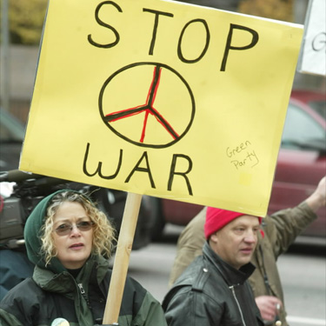
Do Now: What are some ways you can or would protest war? (Make a list)

Slide 2
Objectives: Students will be able to...(1) explain opposition to the Vietnam War (2) write or draw from a given perspective
Homework:
Notes 30.3 (Wednesday)
Vietnam Quiz (Thursday)

Slide 3
Read “An American Story” pg. 904. Answer: 1. How did these people protest? 2. Why do you think people began protesting the war?

Slide 4
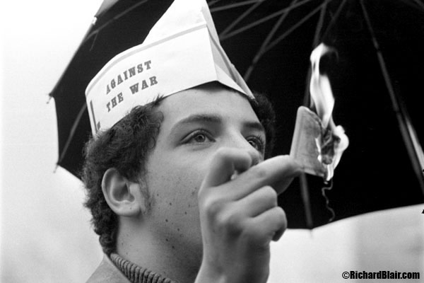
Burning Draft Cards

Slide 5
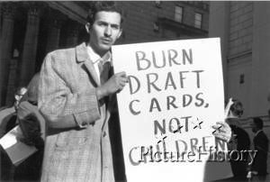

Slide 6
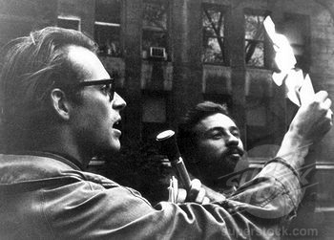

Slide 7
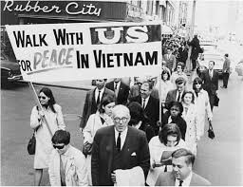
Anger at the Draft
College kids could defer
Low-income end up being sent
Large minority discrepancy
This large number angered Civil Rights leaders
Draft calls increased – 500,000 people refused to go
Protests
Voting Rights (26th Amendment)

Slide 8
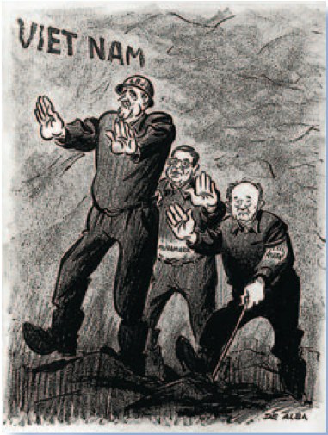
Credibility Gap
Early support for war→ Slowly goes away
Contradicting reports
Credibility Gap – lack of trust or believability
Divide begins…
Hawks: those who want war
Doves: Those opposed

Slide 9
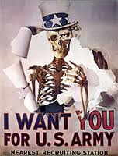
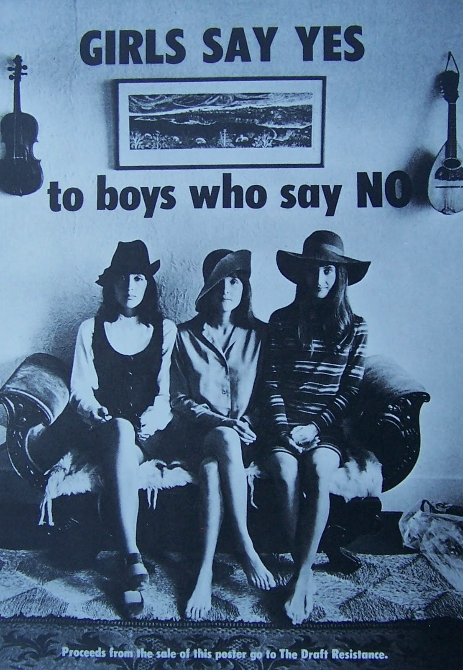

Slide 10
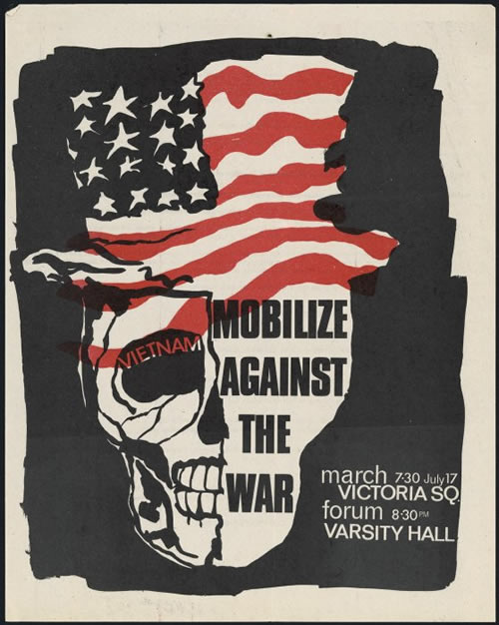

Slide 11
Teach-Ins
Gatherings to discuss issues with the war (Teachers/Students)
Spread throughout the country
People protested for many reasons

Slide 12
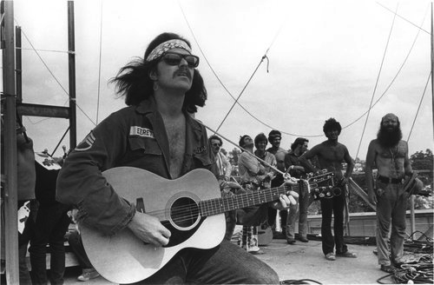
Anti-War Music
As you listen, I want you to write down the purpose or message that the artist is trying to convey

Slide 13
Music
Give Peace a Chance – John Lennon
http://www.youtube.com/watch?v=RkZC7sqImaM
Agent Orange – Joe Macdonald
http://www.youtube.com/watch?v=fk8umoqfz14
I Ain’t Marching Anymore - Phil Ochs
http://www.toptenz.net/top-10-protest-songs-from-the-1960s.php

Slide 14
Create your own form of non-violent protest for Vietnam
Poster
Song
Poster for teach-in
Pamphlet
Letter to the president

Slide 15
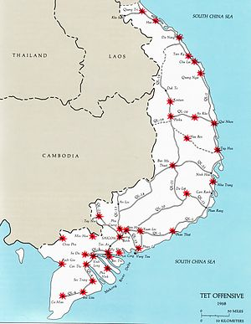
Do Now: Summarize the Tet Offensive
Objectives: Students will be able to...(1) explain the Tet Offensive (2) analyze a video for key information
Homework: Study for Quiz

Slide 16
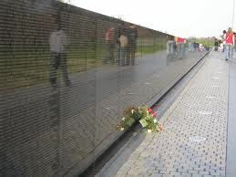
Do Now: Grab a Worksheet and complete with a partner (15 Minutes)
Objectives: Students will be able to...(1) recall key events from the Vietnam War (2) analyze a video for key information
Homework: Notes on 30.4

Slide 17
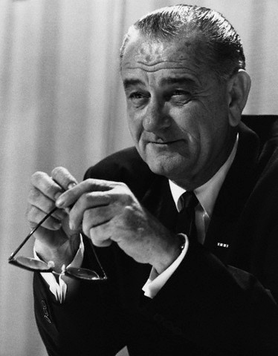
Johnson’s Waning Credibility
Tet Offensive eliminated credibility
Eugene McCarthy (Dove) ran against
Won 40% of primary in NH
Robert Kennedy jumps in
Johnson stuns nation – withdraws

Slide 18
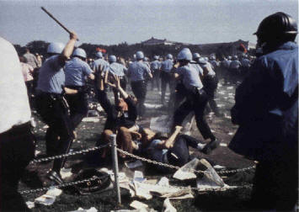
Season of Violence (1968)
MLK Assassinated (James Earl Ray)
Sparked riots
Robert Kennedy (Sirhan Sirhan)
Protests at Dem. National Convention in Chicag0
Riots ensued

Slide 19
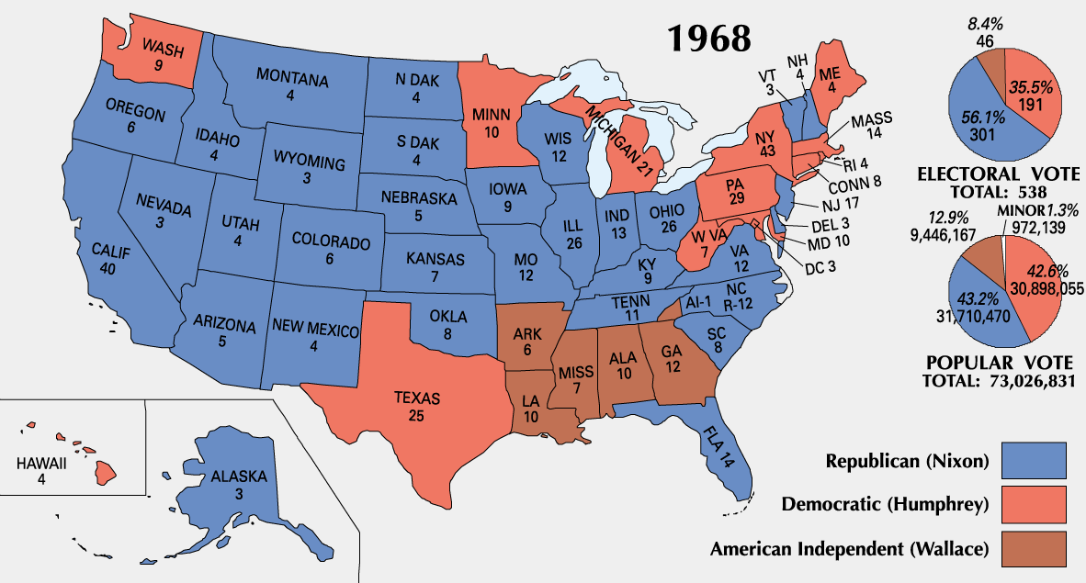
Election of 1968

